Slide 1
Creating stars orbiting in AdS
Nihon University
Keiju Murata
with Youka Kaku, Jun Tsujimura
arXiv:2202.07807 [hep-th]

Slide 2
Introduction

Slide 3
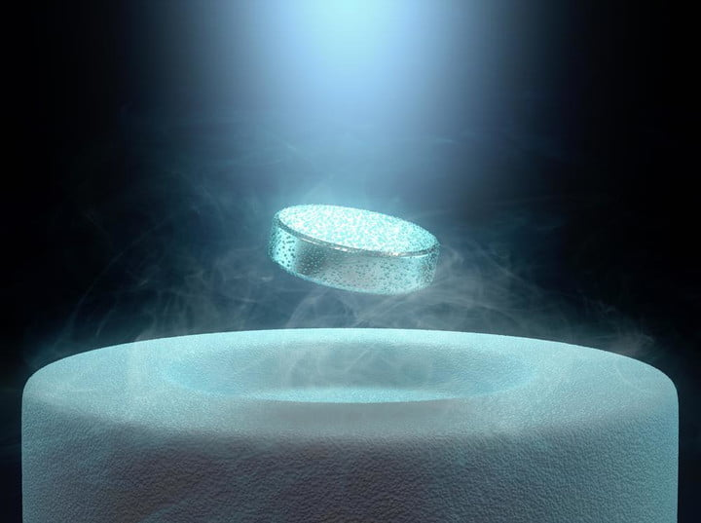
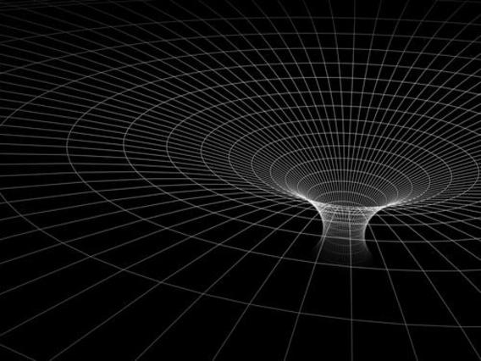
AdS/CFT
Maldacena, 97
Application to realistic systems
(AdS/QCD, AdS/CMP)
Cond-mat
AdS BH
Hartnoll, Herzog & Horowitz, 08
Is there a material which has
its gravitational dual in our world?
Is there any “experimental” way to check the existence of dual gravity?

Slide 4
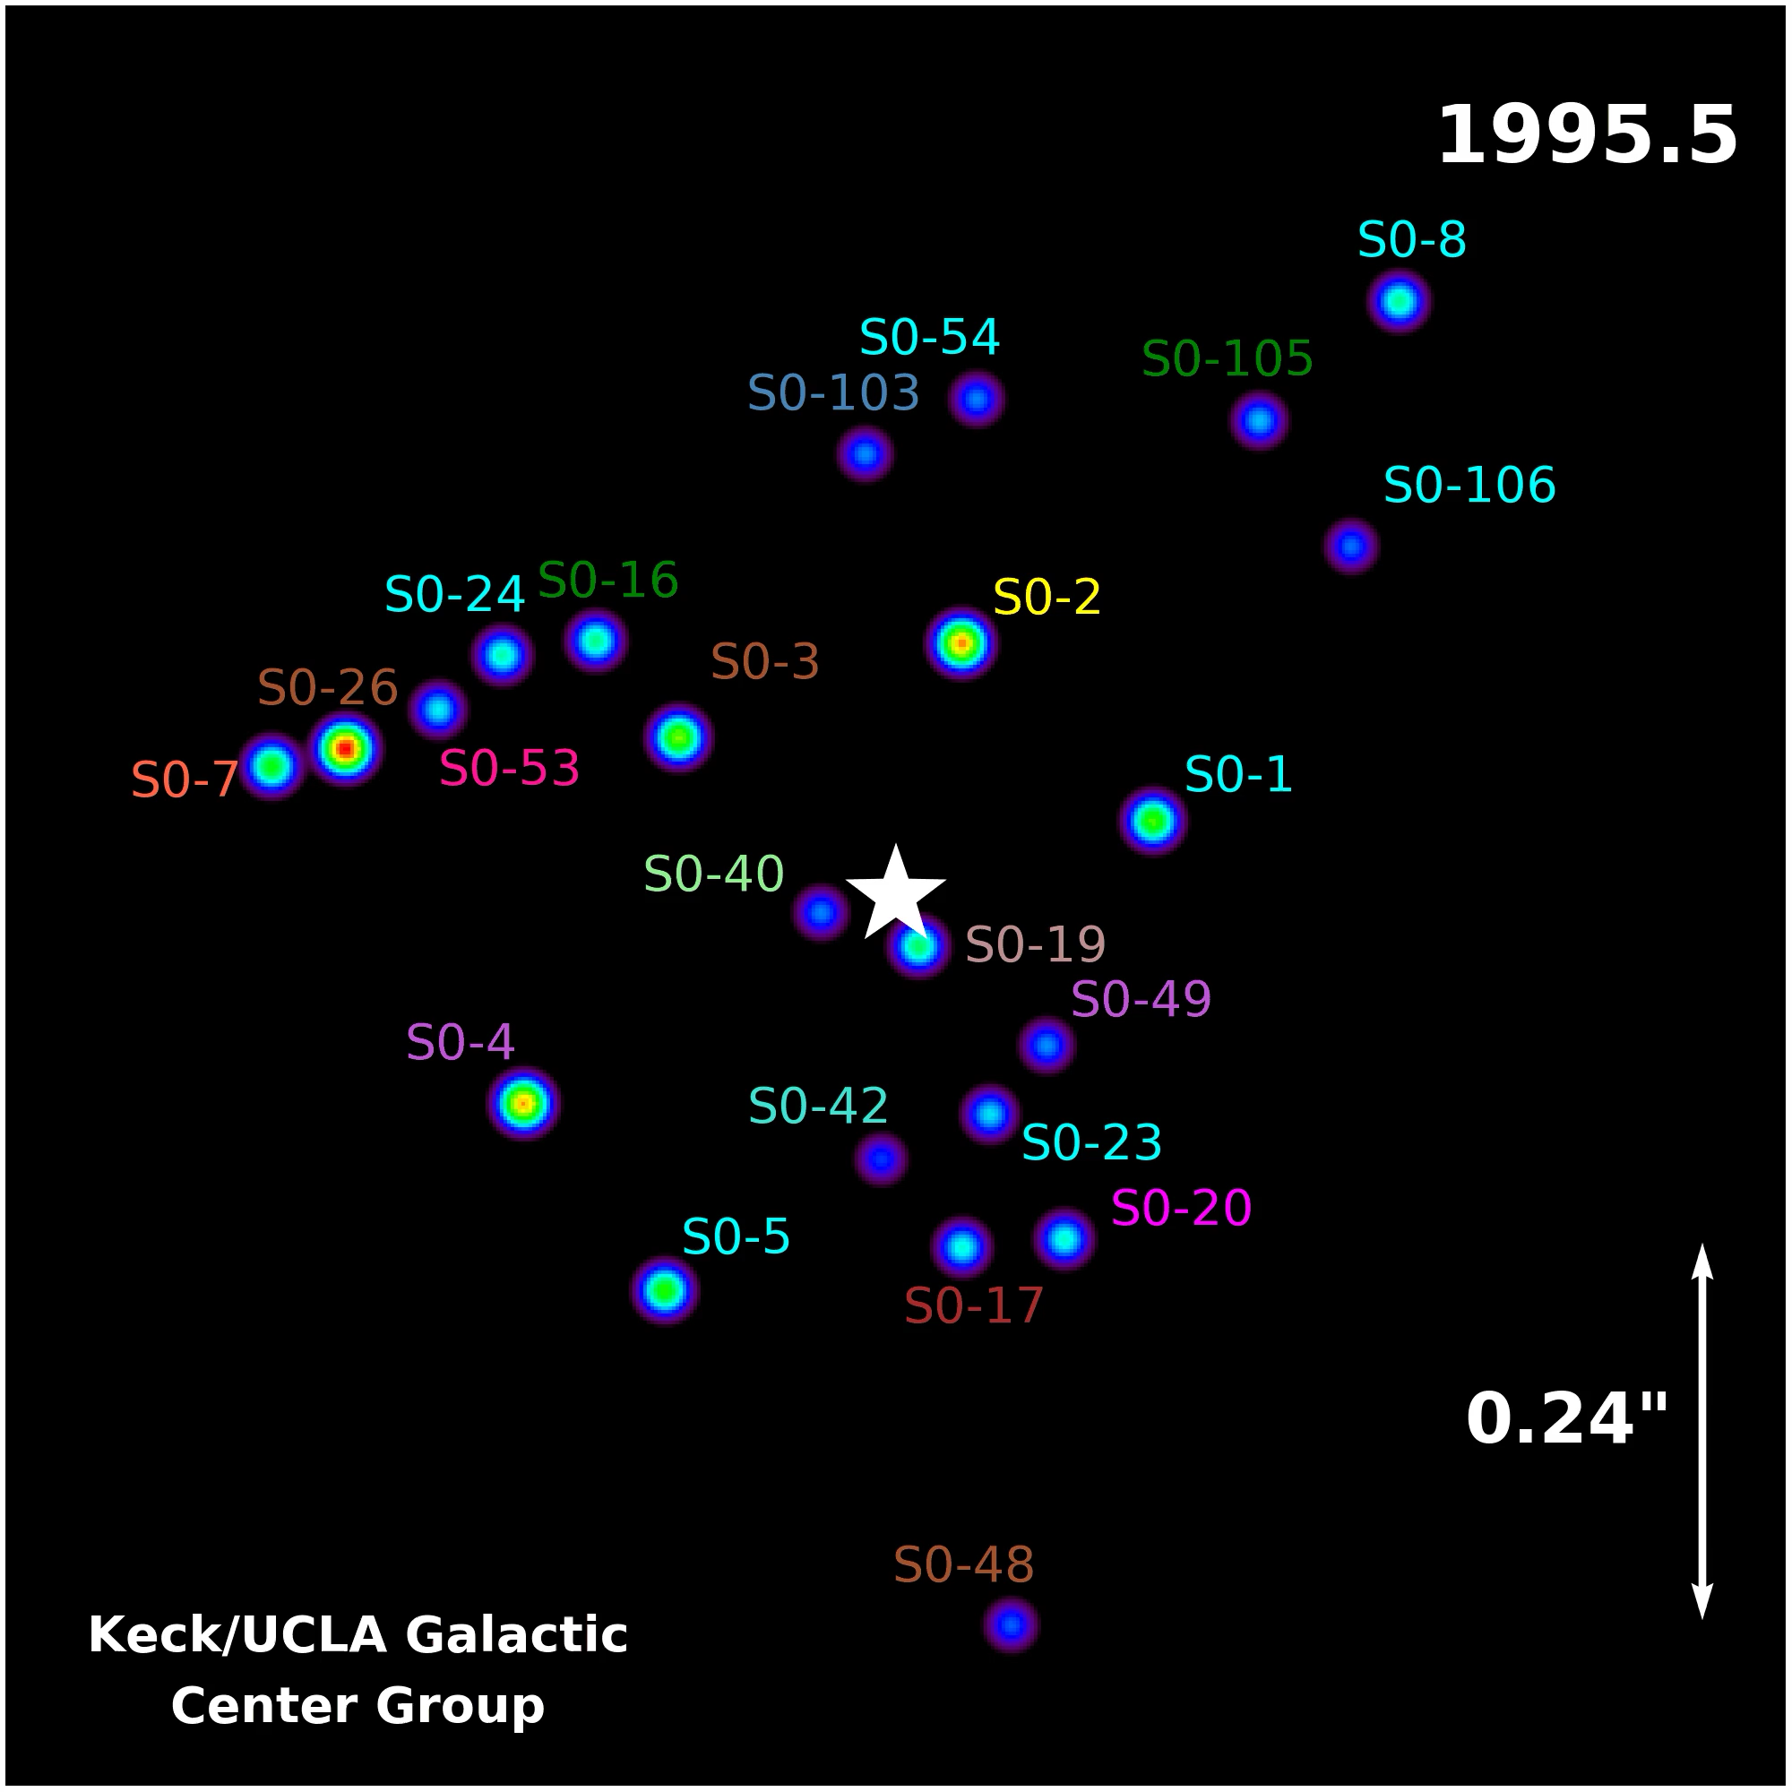
Steller motion around
Sgr A*
Steller motion in
BH spacetime
●Existence of BH
●Information of BH geometry
Keck/UCLA Galactic Center Group
https://www.astro.ucla.edu/~ghezgroup/gc/animations.html

Slide 5
Timelike geodesic in AdS/CFT
Can we create a star (timelike geodesic) orbiting around BH using AdS/CFT?
If it is possible,
can we observe the created star?
Extraction of information about BH geometry from QFT.

Slide 6
Timelike geodesic from
Field equation

Slide 7
Geodesic equation
Sch-AdS4 :
AdS radius=1
Geodesic equation (timelike)

Slide 8
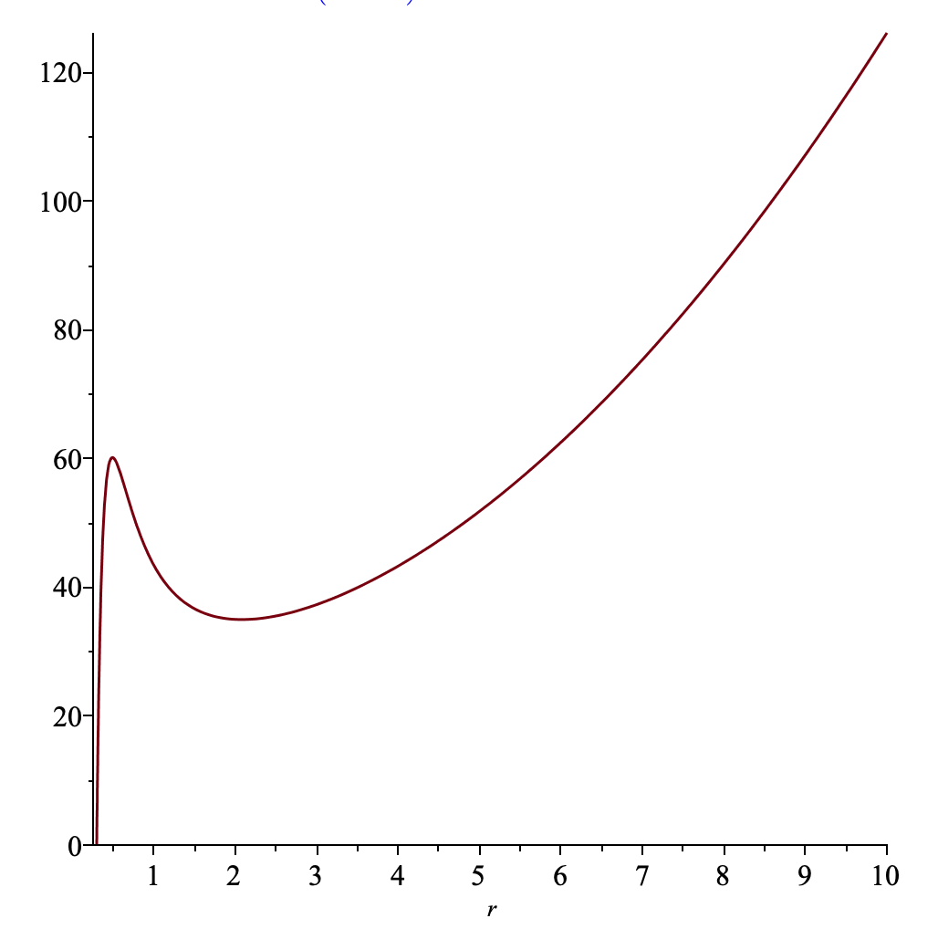
Effective potential
If we put a particle at the AdS boundary, the particle will fall into the BH.
Circular orbit
Realize a particle using a field.
We will gradually make a localize field configuration of the field (particle) using the wave effect.

Slide 9
Geodesic from field
in short wavelength approximation.
(eikonal approximation)
This phase oscillates quickly.

Slide 10
Klein-Gordon → geodesic eq
4-velocity
Deriving
Klein-Gordon → Geodesic eq
in the short wavelengh approx.

Slide 11
Relation of parameters
Energy and angular momentum of geodesic
Energy per unit mass:
Angular momentum per unit mass:
On the other hand, we had

Slide 12
Setup

Slide 13
Massive scalar field in Sch-AdS4

Slide 14
Source and response
Near AdS boundary
non-normalizable
(boundary condtion at r=∞)
normalizable
:external field
:its response
How should we apply the external field in QFT to create a star orbiting in AdS?(inverse problem)

Slide 15
Creating localized star

Slide 16
How to create radially localized configuration?
V
Effective potential
We create the localized configuration of the field at the local minimum.
rh=0.3, l=210, nu=20.5
x
r=∞

Slide 17
Radially localized solution
rh=0.3, l=210, nu=20.5
Eigenfrequency
By choosing the boundary condition at r=∞ (x=0), we want realize this solution.

Slide 18
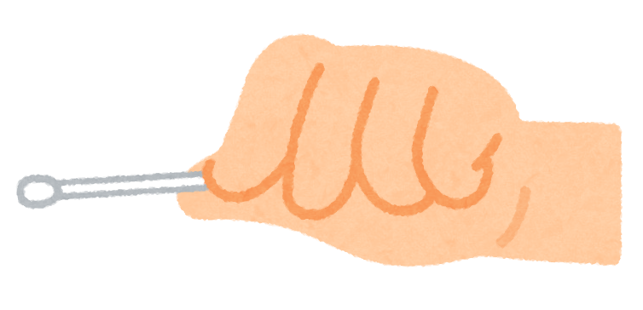
Toy example
How should we shake the endpoint of the string to realize the fundamental tone?
Eigenfrequency
t
t=T

Slide 19
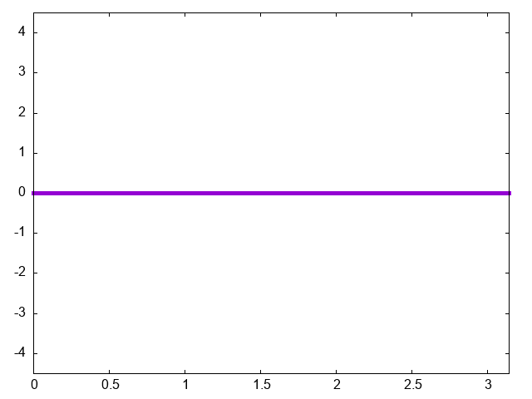
Creating eigenfunctions
n=1
n=2
n=3

Slide 20
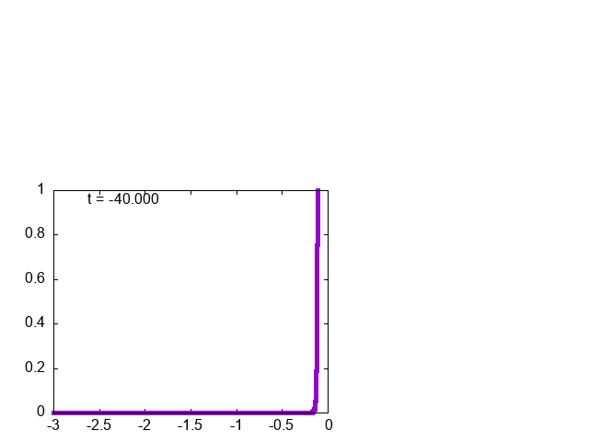
Creation of Localized QNM
t
t=T
We can create radially localized solution for each (l’,m’)-modes.

Slide 21
Superpoisng (l’,m’)-modes
We can also choose to localize the field along the angular direction.
angumar momentum m

Slide 22
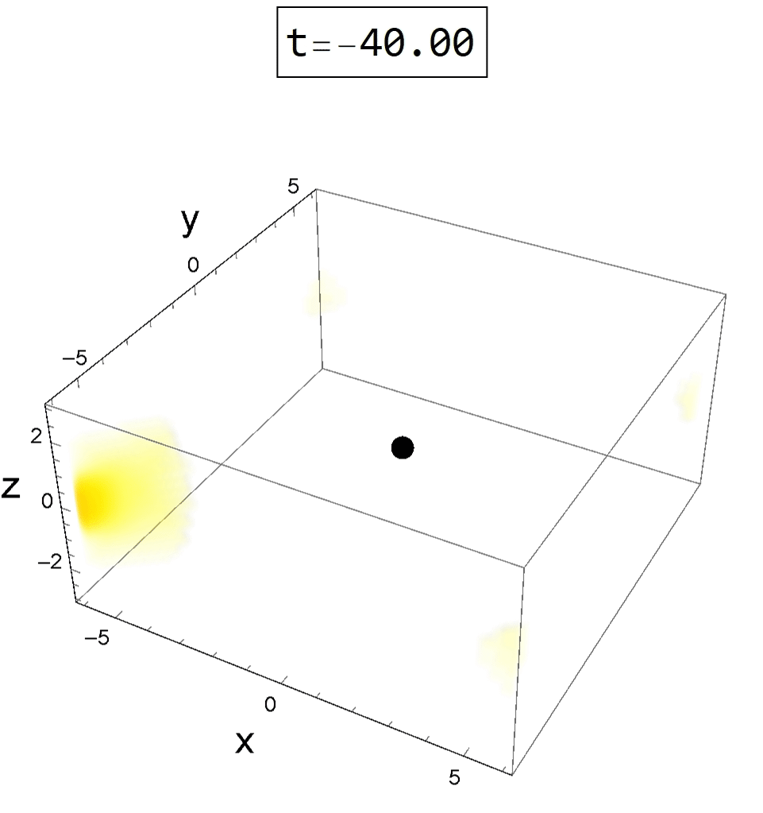
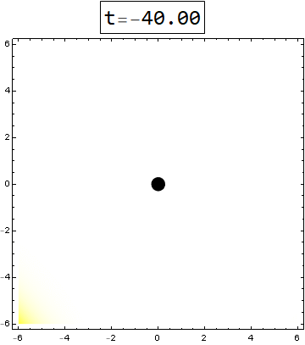
Sch AdS horizon radius=0.3
rh=0.3, m=210, nu=20.5
equatorial plane
We can create the timelike geodesic by manipulating QFT.

Slide 23
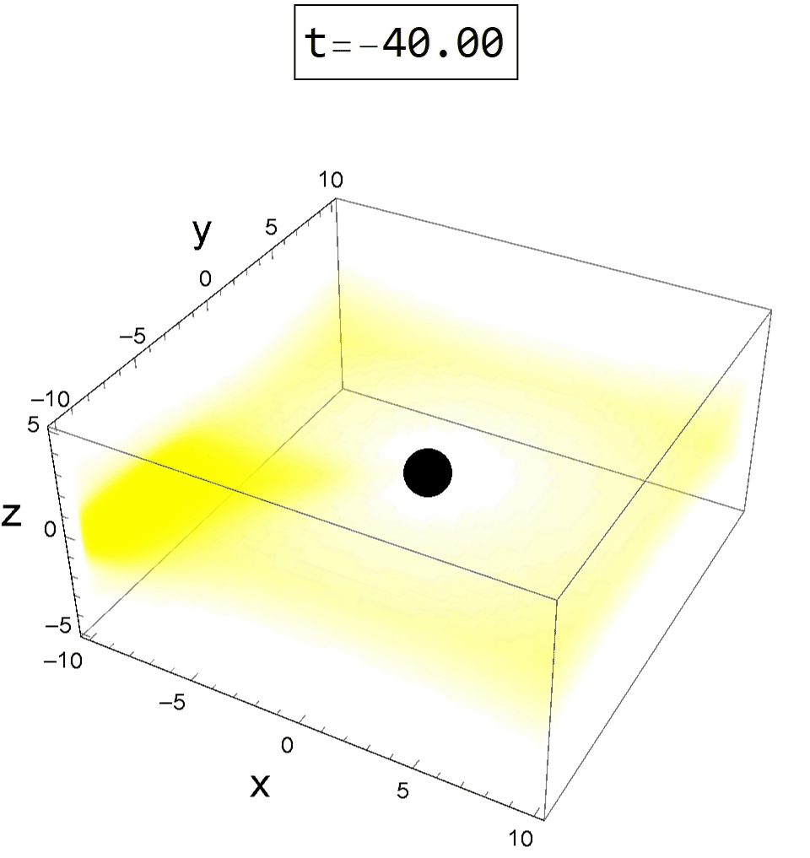
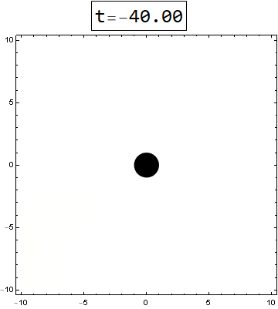
horizon radius=1

Slide 24
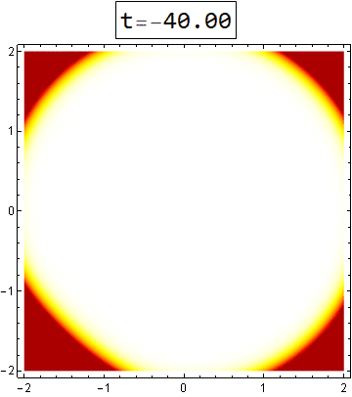
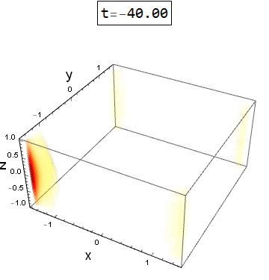
Pure AdS

Slide 25
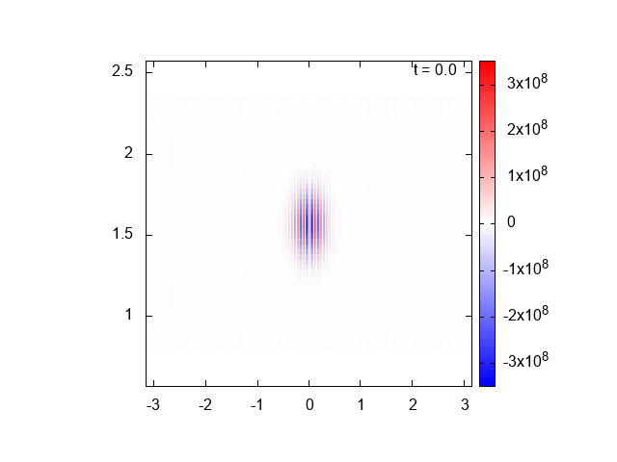
Linear response
We can observe the angular position of the created star from the response.

Slide 26
Parameters of created star
The external field to create a star in the bulk is written as
Energy per unit mass
Angular momentum
per unit mass
Angular velocity of revolution

Slide 27

Implication to gauge/gravity
Circular orbit is in 1-parameter family:
Energy and angular momentum are determined from the orbital radius.
Even if we do not know the metric of the dual geometry, by creating the star in the dual geometry, we can know the relation among ε, j and Ω.
Information of the metric

Slide 28
Summary
If a QFT has its gravity dual, we can create star in the bulk geometry applying appropriate external field.
From the created star, we can read out the information about the bulk metric.

Slide 30

On the source for
For J≠0, Φ→∞.
EM tensor→∞.
Backreaction is not negligible.
We set a cut off at r=Λ and consider dynamics inside it.
Outside of the cutoff, we assume that the theory is modified and regularized in some way.

Slide 31
Quasi normal mode
ωに関する固有値問題
一般にはωは複素数.
quasi normal mode (QNM)
実際上の方程式を解くと、

Slide 32
Future prospect
場の理論の外場をうまく選べば、重力系を操作出来る。
何を作れば面白いだろうか？
●null測地線
外場を与えてから,その応答が現れるまでに時間差があるはず。
●非円軌道
“楕円”軌道・ブラックホールへ落下する軌道など。
角運動量=0の軌道 → BHがあるかないかの判定

Slide 33
Future prospect
●D-brane
D3-D7解は重力解として存在する。pure AdSに外場をかけて、D3/D7系を作れるか？
Kirscha&Vaman, 05
SYMに外場をかけるとQCDになる?
●宇宙論
膨張宇宙をAdS内部に作れるか？
●天文学?

Slide 34
”Gravity-like” phenomena in matter?
本当に、重力双対を持つ物質があったら?
その物質を使って重力特有の現象を観測できるはず。
重力特有な現象？

Slide 35
重力レンズ効果?
重力は光を曲げる。
重力レンズ
ブラックホール存在の状況証拠のひとつ。
Taken from Astrophys. J. Lett. 875:L1

Slide 36
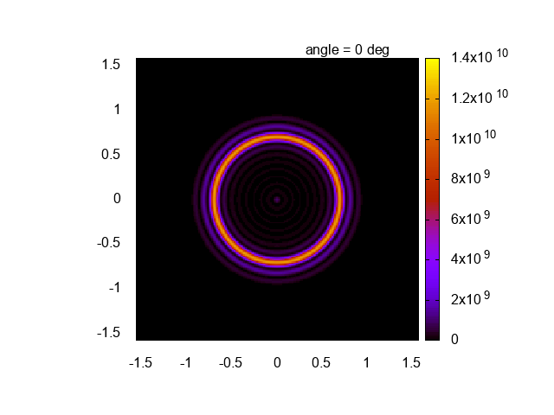
重力レンズ in AdS/CFT
K.Hashimoto, S. Kinoshita, KM, 18,
K.Hashimoto, S. Kinoshita, KM, 19,
Y.Kaku, KM, J.Tsujimura, 21
AdS black holeの像
AdS時空中の“光”を使って、
AdS black holeの姿を見ることが出来る。
時間的測地線も考えられる?

Slide 37
Steller motion around
Sgr A*
ブラックホール周りの
天体の運動の観測
●BH存在の状況証拠
●BH周りの重力場の情報
Keck/UCLA Galactic Center Group
https://www.astro.ucla.edu/~ghezgroup/gc/animations.html

Slide 38
問い
AdS/CFTのセットアップで、
ブラックホール周りを公転する時間的測地線を作り、その運動を観測できないだろうか？
計量の情報の抽出

