Slide 1
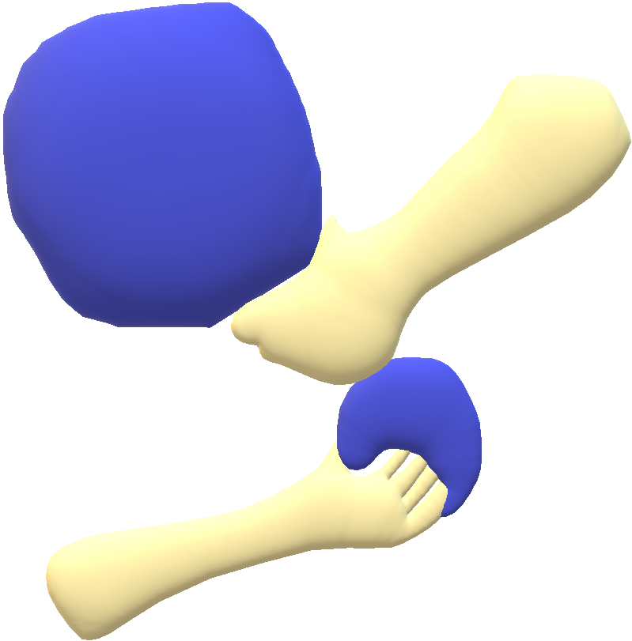
Matter effect on Dynamical compactification in Einstein-YM theory based on JHEP 12 (2018) 085 1810.12291[hep-th] and on-going works
6TH INTERNATIONAL CONFERENCE ON HOLOGRAPHY, STRING THEORY AND SPACETIME IN DA NANG
2023 02 20
Duy Tan University, Pocheon, Korea
Kyung Kiu Kim (Kookmin University)
With
Seoktae Koh(Jeju Univ.), Gansukh Tumurtushaa(Jeju Univ.) Hyun Seok Yang (GIST), Joengwon Ho (Sogang Iniv.)

Slide 2
Outline
Motivation
Einstein-YM theory without matter
Maldacena-Nunez No go theorem
The other possible compact manifolds
Einstein-YM theory with matter
Null Energy condition
Cosmological constant as a matter
Other Matters
Summary and Future Direction

Slide 3
Motivation
String theory naturally introduces 10 or 11 dimensions.
In addition, one can easily find various cosmological models containing extra dimensions.
Why do we prefer the extra dimensions?
They can be hidden easily by an assumption of their size.
It is usually assumed that the extra dimensions are small, so we cannot recognize them.
However, this smallness troubles us since we don’t have any theory which can control this scale.
This study is to understand the extra dimension dynamics.
This is a study on a prehistoric record of our universe.
As a first try, we are using a toy model, which is the Einstein-YM theory.

Slide 4
Einstein-YM theory without matter
For simplicity, we consider SU(2) as the gauge group. The action is
We divide the 8-dimensional spacetime into a toy universe and extra dimensions. ➔ 8 = 4 + 4 = (Universe) + (Extra D=4)
Put an instanton of the YM field on the extra dimensions due to a few benefits of the instanton configuration. ➔ 8 = 4 (Universe) + 4 (Instanton on Extra D)

Slide 5
Einstein-YM theory without matter
Useful properties of Yang-Mills instanton -The Yang-Mills theory admits instanton solutions as classical solutions in the 4-dimensional Euclidean action. These solutions describe non-trivial vacuum configurations. -The 4-dimensional energy-momentum tensor of the instanton vanishes. [using (anti)self-duality] → This property makes it easier to deal with the 8-dimensional equations of motion. - But the action value is still non-vanishing, and such a quantity is related to the instanton number. → This action provides effectively a cosmological constant in the 4-dimensional universe.
To be more precise, the correct terminology for this instanton is an “instantonic solution” in 8-dimension.

Slide 6
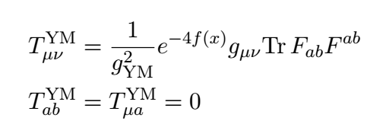
Einstein-YM theory without matter
8-dimensiotnal equation of motion : 4(g) + 4(h)
Taking the 1 instanton solution for the gauge field, the YM equation of motion is easily satisfied.
The energy-momentum tensor
Instanton contribution plays a role of positive cosmological constant with a warping factor.

Slide 7
Einstein-YM theory without matter
Structure of Einstein equation: Universe components + Extra D components where ( instanton action value )

Slide 8
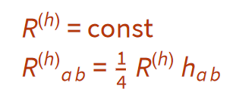
Einstein-YM theory without matter
Let us look at the Extra D eq : - Trace with h → R(h) is a constant. - A constant R(h) requires the extra dimension space should be Einstein.
The toy universe part : where -If f is non-trivial, the instanton density should be a constant.

Slide 9
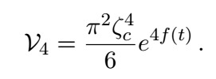
Einstein-YM theory without matter
A simple Einstein manifold with constant curvature. - X4=S4
Then, the full geometry ( Universe ) + ( Warping compact S4 )
The size of the extra dimensions
We will take a more explicit form of the metric later for cosmic evolution. - f(x) has only time dependence.
S4 is conformally flat, and we take FRW-type metric for the universe part.

Slide 10
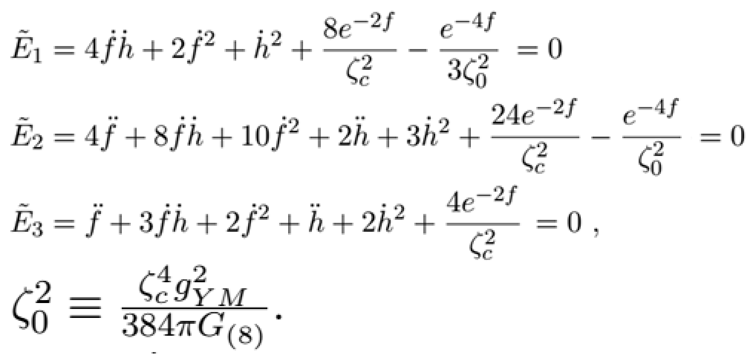
Einstein-YM theory without matter
For the gauge field, we take Jackiw-Norl-Rebbi 1-instanton solution whose instanton density on S4 is constant. - The gauge field equations of motion are satisfied automatically!
The remaining equations of motion (Einstein Equations)
A convenient scaling to simplify the equations of motion.

Slide 11
Einstein-YM theory without matter
Then, the equations of motion become
The first equation is the constraint equation.
Once an initial condition satisfies this relation, this condition is always fulfilled under time evolution.

Slide 12
Einstein-YM theory without matter
To solve the equations of motion, we first solve the constraint equation.
There are two roots:
X+: X < 1 solution set: larger extra dimensions
X-: X > 1 solution set: smaller extra dimensions (Note that X is the inverse size of the extra dimensions: )
The solution space is divided into two solution sets.
The physical size of X=1?
Note that this model has two dimensionful parameters. ( g_YM, G_N )

Slide 13
Einstein-YM theory without matter
X=1 ➔
If we set routinely the couplings in the string theory, the size is the order of the string scale.
Or, by assuming the Weak Gravity Conjecture naively, the size of the extra dimension is much smaller than the Planck scale.
Therefore the classical X- solution set is not a valid description in this model.
We focus on the X+ solution set.
Plugging X+ into the other equations of motion, one can obtain flow equations for the time evolution:

Slide 14
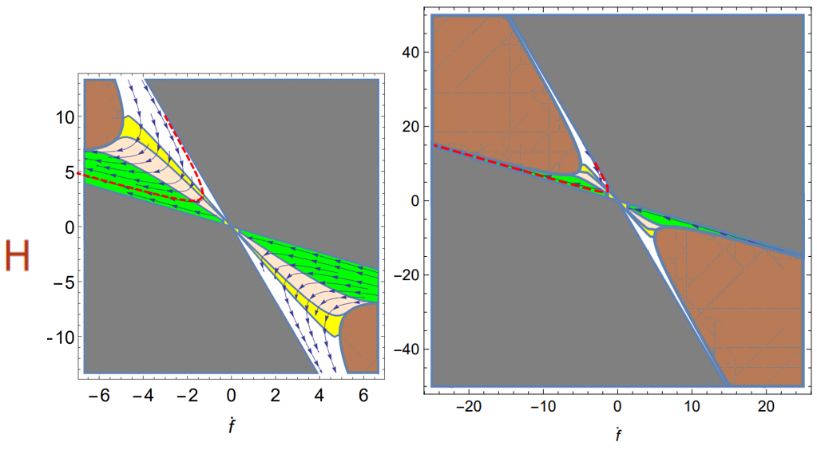
Einstein-YM theory without matter
The solution flow(JHEP 12 (2018) 085, KK, S. Koh, H. Yang): The stream shows the time evolution.
The brown region (Complex X)
The gray region
(Negative X)
Unphysical solution
The boundary of the Brown region
X=1
The boundary of the gray region
→X=0
The infinite size of the extra dimension.

Slide 15
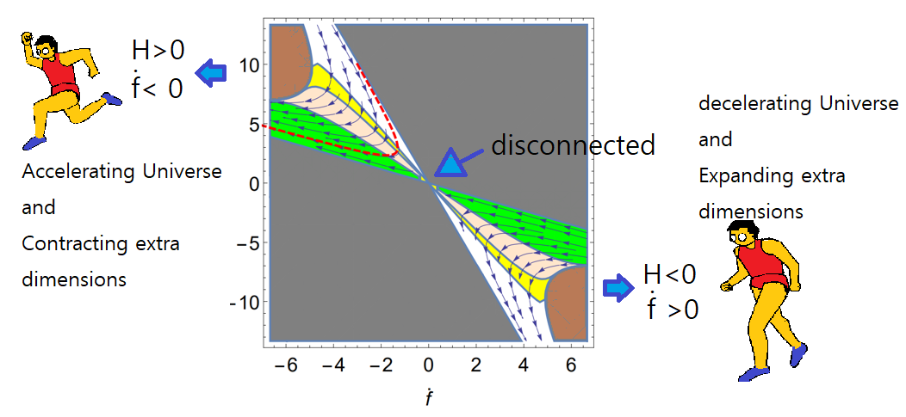
Einstein-YM theory without matter
The toy universe and the extra dimension show the opposite behavior of the warping factors.

Slide 16
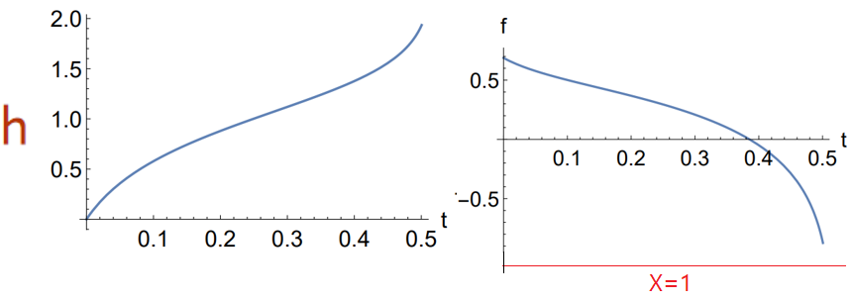
Einstein-YM theory without matter
The upper-left solution flows - The red dashed stream
Expanding universe and Contracting extra dimensions! - Why this behavior happens?

Slide 17
Maldacena-Nunez No go theorem
No regular de Sitter and Minkowski spacetime! ( No higher derivative terms ) - The argument is only for the static case. Our result is an accelerating case. - However, this is very useful for understanding our results.
Key equation - They showed the no go theorem using very general matters.
Without a positive cosmological constant, de Sitter or Minkowski is not possible for the regular warping factor.

Slide 18
Maldacena-Nunez No go theorem
In our case
The first term plays a very important role.
The accelerating toy universe can be generated by the positive Hubble parameter function together with the dynamical compactification.
Therefore, the dynamical compactification is the source of the accelerating universe.

Slide 19
The other possible compact manifolds
4d compact manifold should be Einstein with constant curvature.
Which manifold is consistent with SU(2) YM ? Constant tr(FF)?
The candidates are
The construction of an instanton solution on each manifold?
It is well known that a SU(2) gauge field configuration can be identified with vierbeins of each compact manifold.
Then the equation of motion for the gauge field can be satisfied using the torsion-free condition.
Then, such a solution can be projected into self-dual part and anti self-dual part.
One may take one of them.

Slide 20
The other possible compact manifolds
In order to satisfy the Einstein equation, the action density of the gauge field should be constant. - I.e., Tr ( F F ) is a constant.
This quantity is proportional to the Kretschmann invariant.
The Page manifold is excluded because it has a non-constant Kretschmann scalar.
Therefore, the possible compact manifolds consistent with our setting is
The solution flows are the same with the result of S^4.

Slide 21
Einstein-YM theory with matter
Let us take a perfect fluid matter - Note that there are two kinds of pressures.
Then the remaining equations of motion to be solved:

Slide 22
Einstein-YM theory with matter
The first equation is again a constraint (Hamiltonian constraint).
This combination of the equations is equivalent to the energy-momentum conservation.
Again, a similar scaling is taken to simplify the expression of the equations of motion.

Slide 23
Einstein-YM theory with matter
Then, the general equations of motion including matter are where H is the Hubble parameter function( d/dt h ) defined earlier. In addition, X is again the inverse size of the extra dimensions.

Slide 24
Einstein-YM theory with matter
We follow the same procedure with the constraint.
The inverse size X has two roots:
X+: X < 1 solution set: larger extra dimensions
X-: X > 1 solution set: smaller extra dimensions - We will take X+ again for the same reason. The {X-} solution set with too small extra dimension cannot be described by the classical Einstein gravity.

Slide 25
Einstein-YM theory with matter
Plugging X+ into the other equations of motion, one can obtain flow equations for the time evolution: with
For a given equation of state, one can find the solution flows in 3-dimensional parameter space {d/dt f, H, energy}.

Slide 26
Null Energy condition
Including matters to the gravity system, the energy condition is crucial to describe a physical system.
We adopt the null energy condition.
Null Energy Condition (NEC) - For any null vector n,

Slide 27
Null Energy condition
Using the isometry of the metric, the null vector can be taken as where
Then, the NEC becomes
Therefore, the NEC condition is - One may notice that there is a contribution from the instanton and the extra dimensions.

Slide 28
Cosmological constant as a matter
To get an insight into full solution space, we consider the following equations of state:
The energy-momentum conservation is satisfied.
This simplest matter is nothing but the cosmological constant.
The solution flow equation is , and the inverse size of the extra dimensions is
Then, we can find various solutions flows.

Slide 29
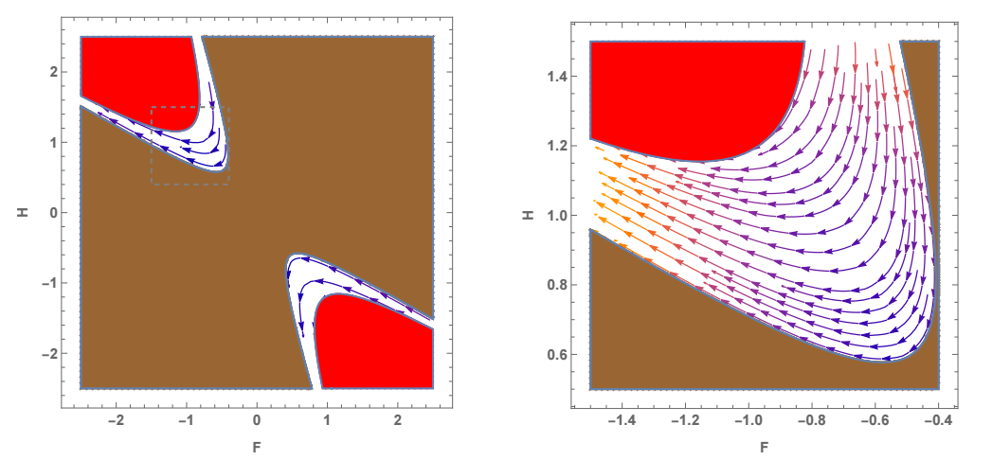
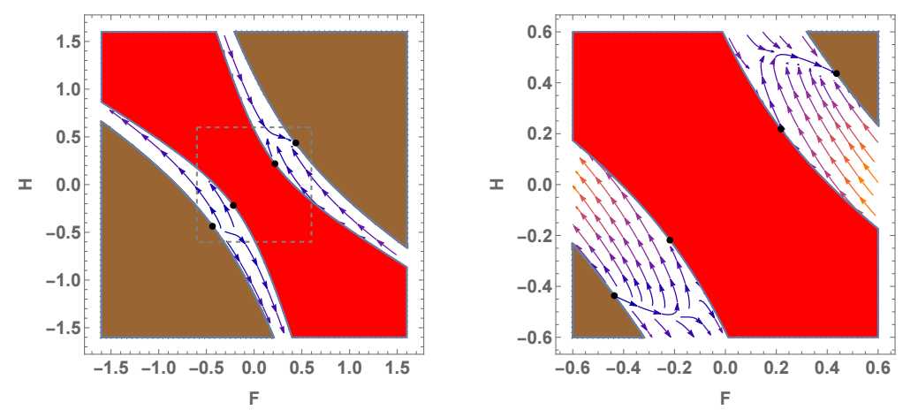
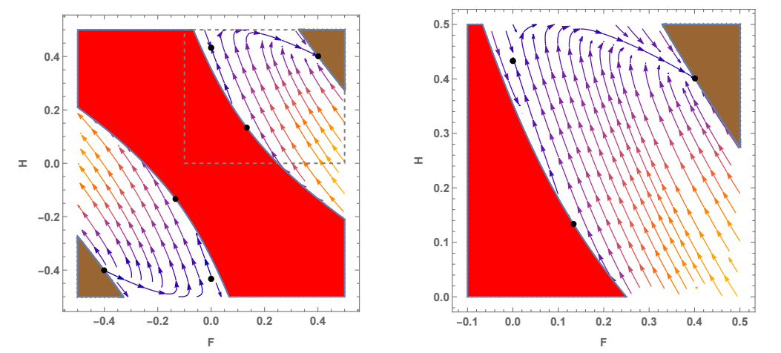
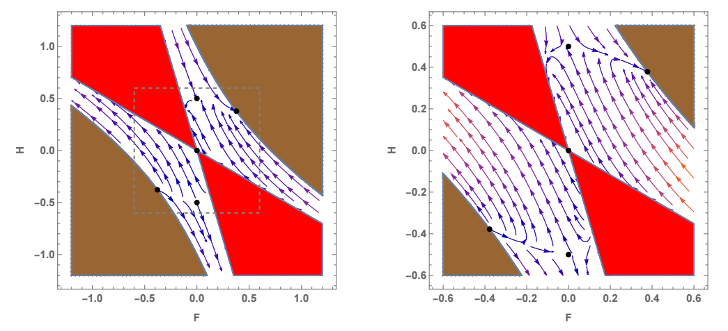
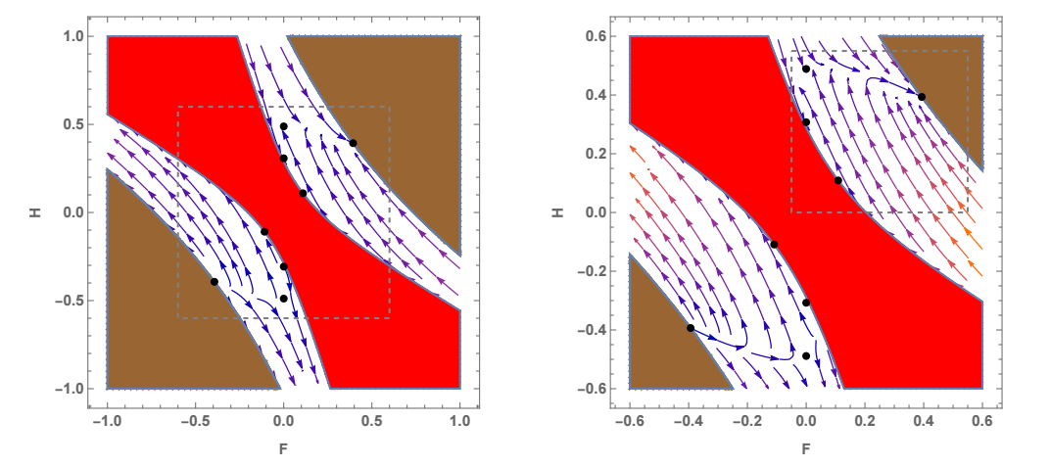
Cosmological constant as a matter
Flat space universe is possible. (Salam et al 1984)
One of the best ways to analyze this nonlinear system is to classify fixed points of the differential equations.

Slide 30
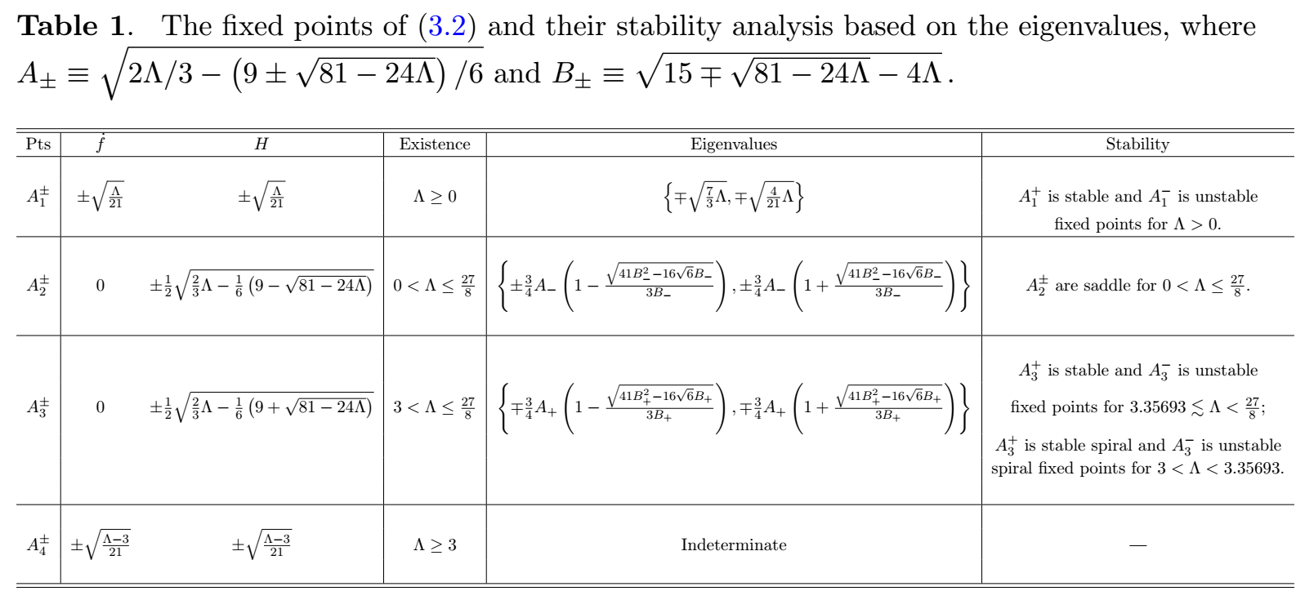
Cosmological constant as a matter
The fixed point analysis is important.

Slide 31
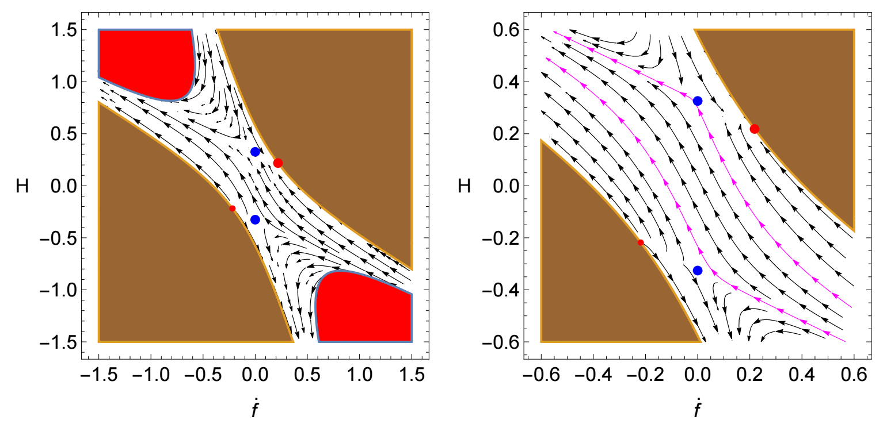
A bouncing universe
Bouncing Universe: H<0 ➔ H > 0 and df > 0 ➔df < 0

Slide 32
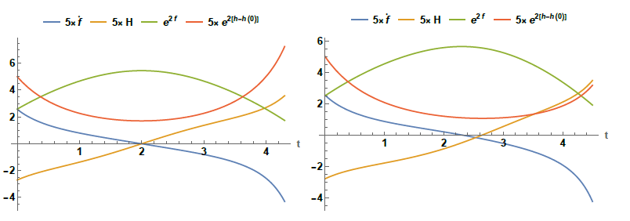
Cosmological constant as a matter
In this toy universe case, a smooth bouncing solution is possible.
Near the red region, X is close to 1. This region is a quantum gravity region.
In our setting, the higher derivative correction is desired to be considered.

Slide 33
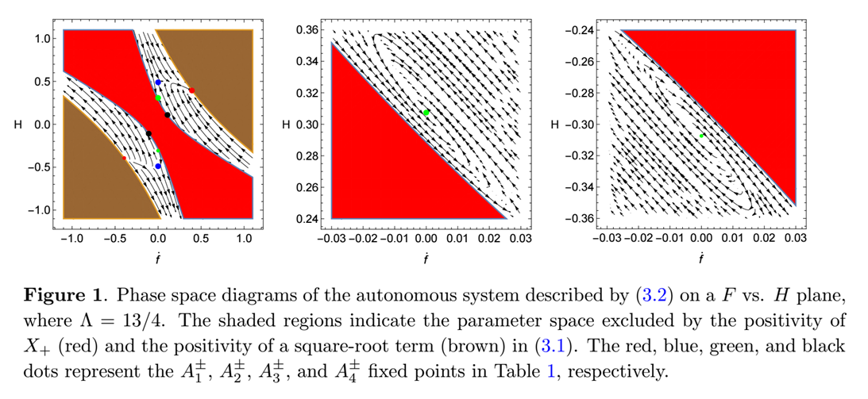
De Sitter universe
Another interesting cosmic evolution is a spiral evolution approaching a de Sitter universe.
Due to the positive cosmological constant, this is not a counter-example of the MN no go theorem.
The final de Sitter solution is a stable fixed point.

Slide 34
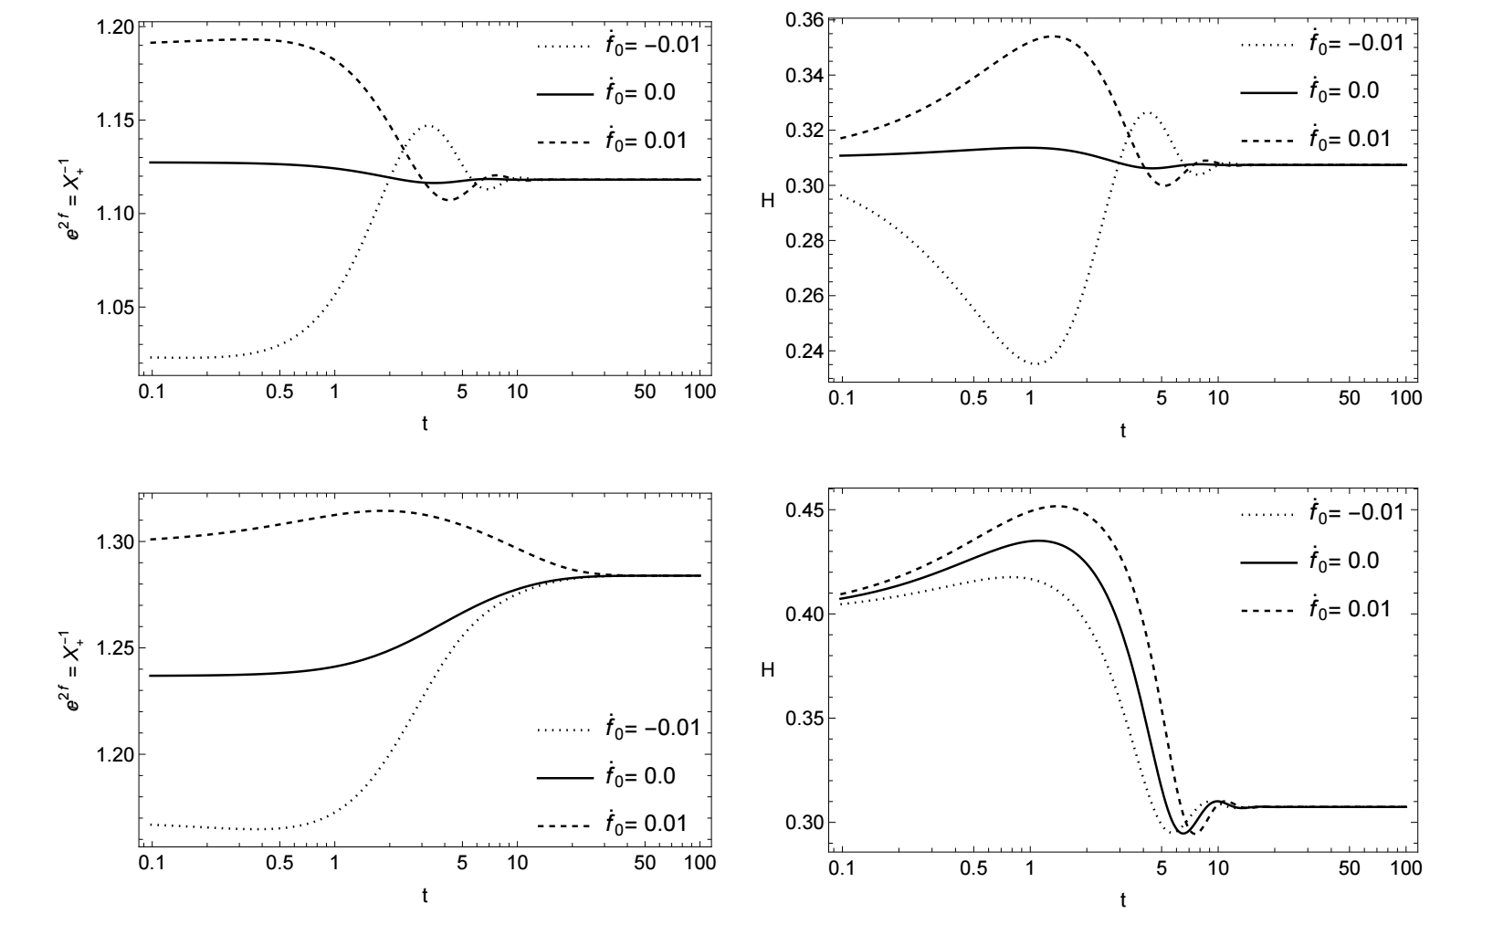
The extra dimensions can be stabilized after some oscillation

Slide 35
Cosmological constant problem
4-dimensional Newton constant
Hubble parameter
With ,

Slide 36
Other matters (1) NEC matter
Bound of NEC
The conservation law can be solved by - The energy density has a background constant value.
The equations of motion
The inverse size is determined as (The other root is negative.)
The physical condition

Slide 37
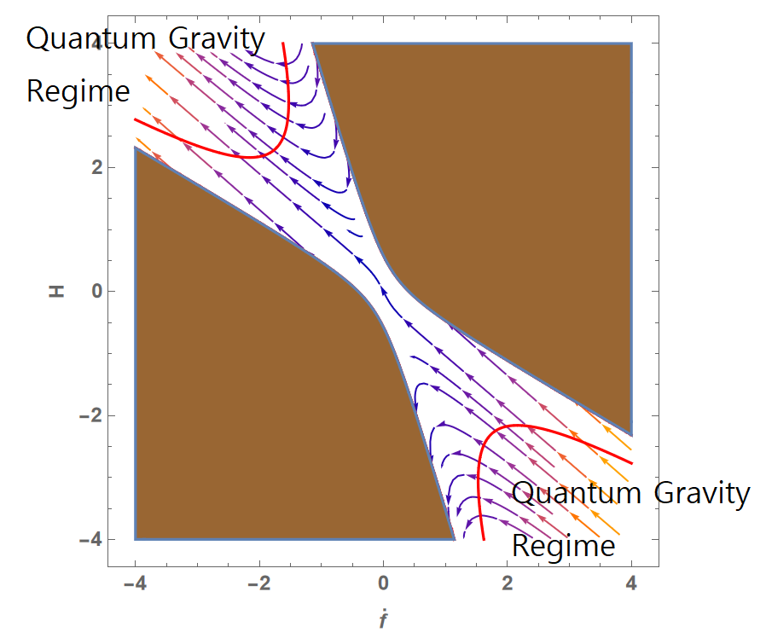
An example ( epsilon_0 =1 )
We need a quantum gravity effect such as higher derivative correction (ongoing work)
Bouncing Universe gain!

Slide 38
Other Matters
The other variation of the NEC matters - More general equation of state can be considered.
Some special case such as A=0 gives the energy density proportional to the inverse size of the extra dimensions. However we need still

Slide 39
Other Matters (2) scalar field
In most popular cosmological models, the scalar field (Inflaton potential) makes inflating dynamics.
On the other hand, the instanton plays the role of source for inflating dynamics in our model.
We want to see what happens when we consider the instanton and a real scalar.
The energy-momentum tensor of a scalar field
The energy density and the pressures
We can use the general solution flow with w_3=w_4

Slide 40
Finding potential corresponding to a “history function”
If we regard H as a given “history function”, one can find an equation of state and a flow equation set:
By solving these differential equations, the potential can be determined.
For example, if we take H as a positive constant corresponding to de Sitter Universe.

Slide 41
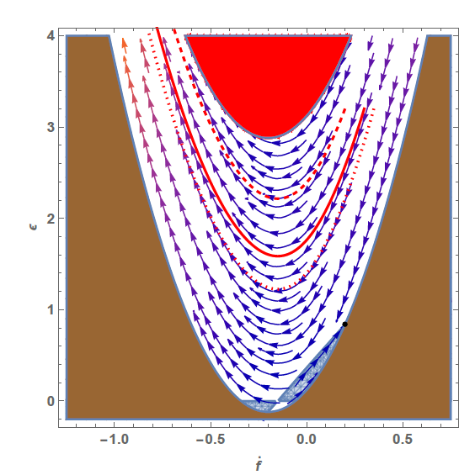
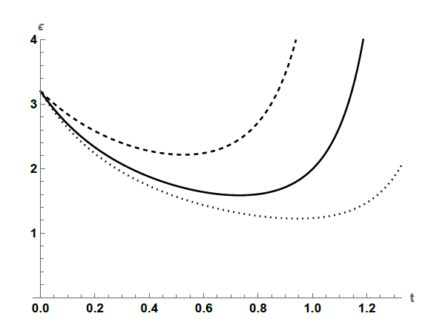
Other Matters (2) scalar field
We can find a time-dependent solution for de Sitter with dynamical compactification.
The energy density and the extra dimension size are bouncing.
Near the red region, we need to consider a quantum gravity effect.
One possible direction is a consideration of higher derivative corrections.

Slide 42
For a certain Hubble constant, we can construct a scalar potential.
H_0=0.2

Slide 43
Comment on Higher derivative correction
Most of the dynamical compactification approach X=1. Near X=1 Einstein gravity is not a nice description of the dynamics.
We need the higher derivative correction to make up this weak point.
We speculate that the higher derivative correction can give repulsive dynamics from X=1. Then, the size of the extra dimensions could be stabilized.

Slide 44
Summary and Future Direction
Instanton Universe + 0X(matters) → Dynamical compactification with accelerating Universe → We found all the possible manifolds which can be contained in our model. → MN no go theorem was considered, and we found that dynamical compactification is very important to obtain the accelerating universe.
Instanton Universe + matters → We found the general equations of motion for the perfect fluid matter. → We found an NEC for this model. → various kinds of cosmological evolution including dynamical compactification → Some solutions are describing bouncing universes. → Some solution shows the dS universe with stabilized compact dimensions. → The NEC matter is easy to handle, and some generalizations remain. → The scalar field case is constructed by general equations of motion.
We need higher derivative terms to describe very small extra dimensions.

Slide 45
Summary and Future Direction
Future Directions - Higher derivative terms - Embedding in D=10 or D=11 model or string theories - Realization of the cosmological constant from another extra dimension - Relation to the swampland argument.
A possible scenario:
A Large extra dimensions (Minkowski) → Creation of An instanton → Accelerating Universe and Dynamical compactification → Higher derivative of QG corrections stabilize the small extra dimensions

Slide 46
Thank you !

