Slide 1
Interaction between several types of cosmic strings
Siyao Li
PhD at Tokyo Institute of Technology, Tokyo
Based on ongoing work in collaboration with
Kohei Fujikura(Kobe Univ.), Masahide Yamaguchi
6TH INTERNATIONAL CONFERENCE ON HOLOGRAPHY, STRING THEORY AND SPACETIME
Da Nang, Vietnam
2023.02.21

Slide 2
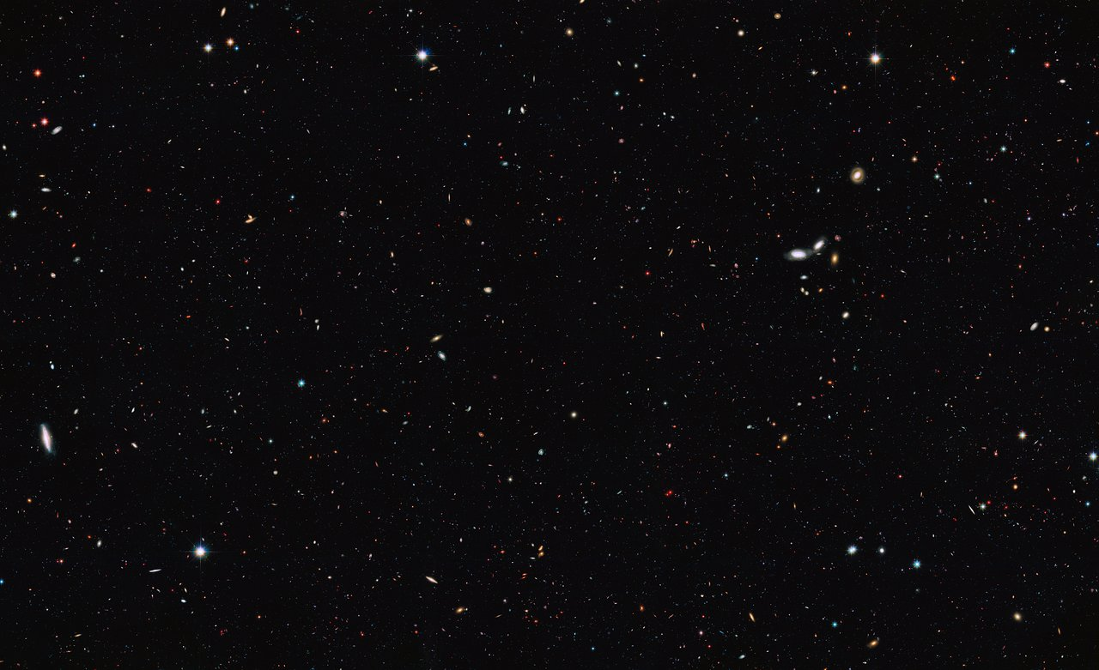
Introduction
Purpose of this work:
to investigate interaction between two cosmic strings
What happen?
Attractive?
Repulsive?

Slide 3
Contents
Introduction
Apply source method* to derive interaction energy of two strings for:
Local Cosmic Strings
Bosonic Superconducting Cosmic Strings
Global Cosmic Strings
*originated by J. M. Speight in Phys. Rev. D 55, 3830 (1997) for abelian-Higgs model
Numerical results for two-string system
Summary

Slide 4
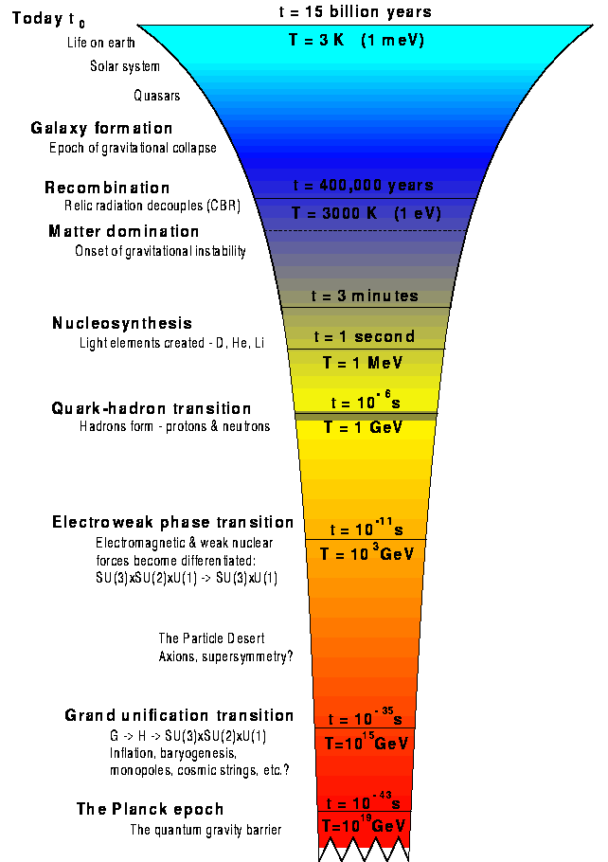
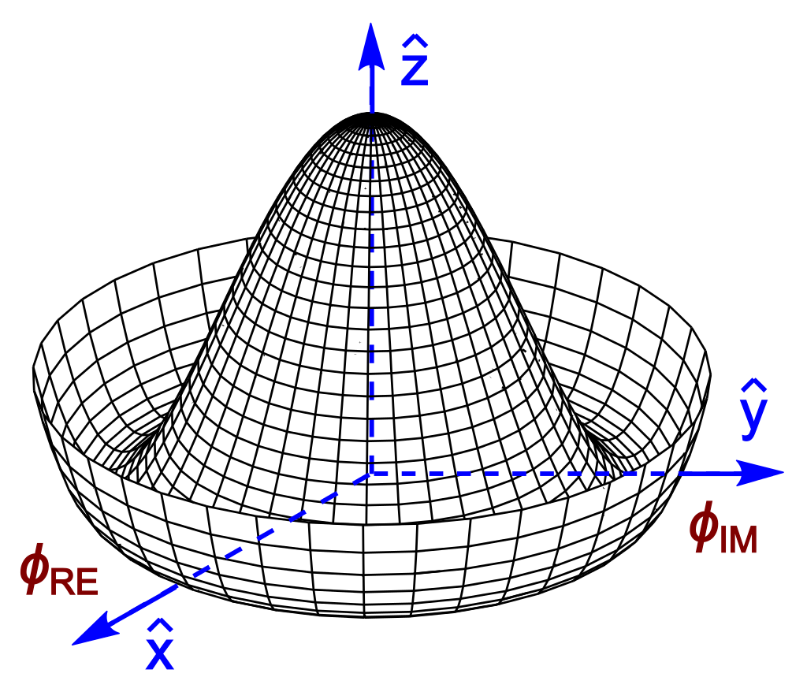
Introduction
Independent regions
2
1
Φ1
Φ2
Phase variation $2πn$
Φn
$ξ（$t）: Correlation length
[Kibble, Physcs Reports,1980]
Spontaneous symmetry breaking during phase transition
Upper limit of current experiment
Cosmic strings (topological defects)
Natural high energy experiment lab

Slide 5
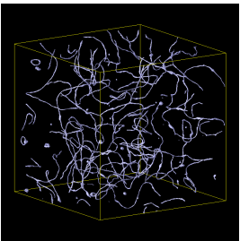
Introduction
Cosmic strings network
interactions, dynamics...
reconnect, collapse…
kinks, cusps,
Y-junctions
[Takashi.H et al. 2013]
Y-junction
stochastic gravitational wave
gravitational wave burst
+

Slide 6
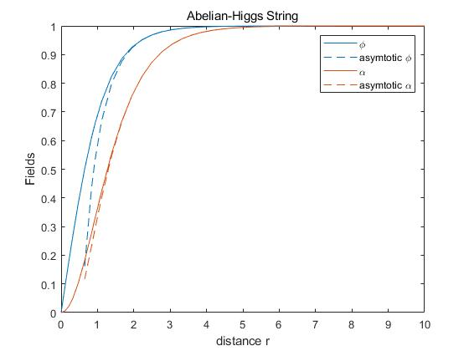
Local strings
Boundary conditions:
Regularity at the origin
$\left|φ\right|=0, A_{μ}=0$at $r=0$
Finite energy
$\left|φ\right|→η_{φ}, { D}_{μ}φ→ 0,$at $r→∞$
Abelian-Higgs model
$$ℒ_{AH}=−\frac{1}{4}F^{μν}F_{μν}+{\left|D_{μ}φ\right|}^{2}−V\left(φ\right), V\left(φ\right)=\frac{1}{4}λ{\left({\left|φ\right|}^{2}−η^{2}\right)}^{2}$$
$U(1)$ gauge symmetry
static, straight, circular symmetric
Local string solution:
Asymptotic solutions at large distance:
$$σ\left(r\right)=k_{φ}K_{0}(m_{φ}r)$$
$$U_{θ}(r)=k_{e}rK_{1}(m_{e}r)$$
modified Bessel function $K_{i}\left(mx\right)∝e^{−mx}$ at $x→∞$
$$φ=|φ\left(r\right)|e^{inθ},$$
$$A_{μ}=A_{μ}（r）δ_{θ}^{μ}$$
n: winding number
$$k_{φ}∝−|n|$$
$$k_{e}∝−n$$
in cylindrical coordinate system $\left(r, θ,z\right)$
with parameterization
$$φ\left(r\right)=\left(η_{φ}+\frac{σ\left(r\right)}{\sqrt{2}}\right)e^{inθ},{ A}_{θ}\left(r\right)=U_{θ}\left(r\right)+\frac{n}{e}$$
$$m_{φ}≡\sqrt{λ}η$$
$$m_{e}≡\sqrt{2}eη$$
[Nielsen, Olesen P. Nuclear Physics B, 1973]

Slide 7
Point source approximation
Define the external sources representing the asymptotic fields by linearized field theory,
$$ℒ=\frac{1}{2}{\left(∂_{μ}σ\right)}^{2}−\frac{1}{2}m_{φ}^{2}σ^{2}−\frac{1}{4}F^{μν}F_{μν}+\frac{1}{2}m_{e}^{2}U_{μ}U^{μ}−J_{σ}σ−j_{μ}U^{μ}$$
parallel, well-separated strings
xy-plane
point sources 1
xy-plane
external sources
point sources 2
substitute the asymptotic solutions
$d>$ string widths
Then, interaction energy can be computed analogously to Yukawa potential.
$$J_{σ}=−\frac{k_{φ}}{r}δ\left(r\right)$$
$$j_{θ}=−\frac{k_{e}}{m_{e}}∂_{r}(\frac{1}{r}δ\left(r\right))$$
scalar monopole
magnetic dipole moment
point-like sources in 2-dimensions

Slide 8
Point source approximation
We assume superposition of two sources (for two well-separated strings)
$$J_{total}\left(x\right)=J_{1}\left({x−x}_{1}\right)+J_{2}\left(x−x_{2}\right)$$
$E_{int}=2π\int{dz}$ $[−k_{φ1}k_{φ2}K_{0}\left(m_{φ}d\right)+k_{A1}k_{A2}K_{0}\left(m_{e}d\right)]$
always attractive contribution
determined by winding direction of vortex:
Same direction: repulsive
Opposite: attractive
cancel when $m_{φ}=m_{e}$,
i.e. when $G≡\frac{λ}{2e^{2}}=1$, $E_{int}$= constant

Slide 9
Bosonic superconducting strings
Bosonic superconducting model
$$ℒ_{BC}=−\frac{1}{4}F^{μν}F_{μν}+{\left|D_{μ}φ\right|}^{2}−\frac{1}{4}\tilde{F^{μν}}\tilde{F_{μν}}+{\left|\tilde{D_{μ}}\tilde{φ}\right|}^{2}−V\left(φ, \tilde{φ}\right), V\left(φ, \tilde{φ}\right)=\frac{1}{4}λ_{φ}{\left({\left|φ\right|}^{2}−{η_{φ}}^{2}\right)}^{2}+\frac{1}{4}λ_{\tilde{φ}}{\left({\left|\tilde{φ}\right|}^{2}−{η_{\tilde{φ}}}^{2}\right)}^{2}+β{\left|φ\right|}^{2}{\left|\tilde{φ}\right|}^{2}$$
Parameter space:
$\tilde{U}(1)$ symmetry unbroken outside string
$$m_{\tilde{φ}}^{2}\left(r→∞\right)>00$$
$\left|φ\right|=η_{φ}, \left|\tilde{φ}\right|=0$ should be global minimum
To make $\left|\tilde{φ}\right|≠0$ energy favorable rather than trivial solution $\left|\tilde{φ}\right|=0$
[Witten, Nuclear Physics B, 1985]
$U\left(1\right)$ symmetry to be spontaneously broken
$\tilde{U}(1)$ symmetry to be unbroken outside the string
giving rise to ANO string
$U(1)×\tilde{U}(1)$ gauge symmetry
making the string carry persistent current
(existence of negative energy state)

Slide 10
Bosonic superconducting strings
static, straight, circular symmetric
Then a general ansatz is
$$\tilde{φ}={\tilde{φ}}_{r}\left(r\right)e^{−is\left(r\right)α(z)}, \tilde{A_{μ}}=−\frac{1}{g}α(z) ∂_{μ}s\left(r\right)$$
[Alford M et al. Nuclear Physics B, 1991]
$$\tilde{φ}={\tilde{φ}}_{r}\left(r\right), \tilde{A_{μ}}=\frac{1}{g}s\left(r\right)∂_{μ}α(z)$$
$$≡\tilde{s}(r)$$
$$r∂_{r}s∂_{z}^{2}α=0$$
$$\frac{1}{r}∂_{r}\left(r∂_{r}\right)s\left(r\right)−2g^{2}s\left(r\right){\tilde{φ}}_{r}^{2}=0$$
$$α(z)=ωz$$
London Equation
with penetration depth $δ_{A}(r)=1/g{\tilde{φ}}_{r}(r)$
Superconducting current along the string
$$J_{z}=∫d^{2}x[−2gωs\left(r\right){\tilde{φ}}_{r}^{2}]$$

Slide 11
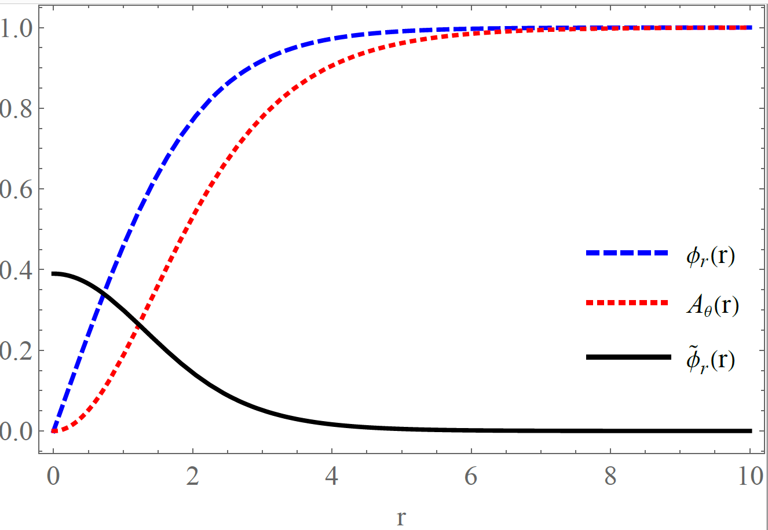
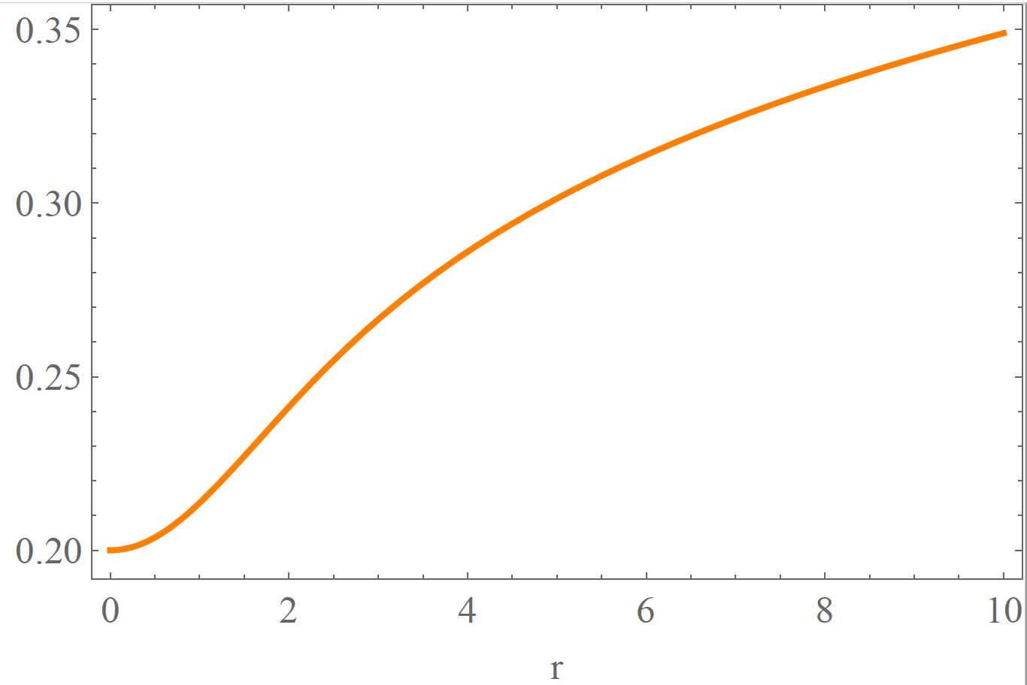
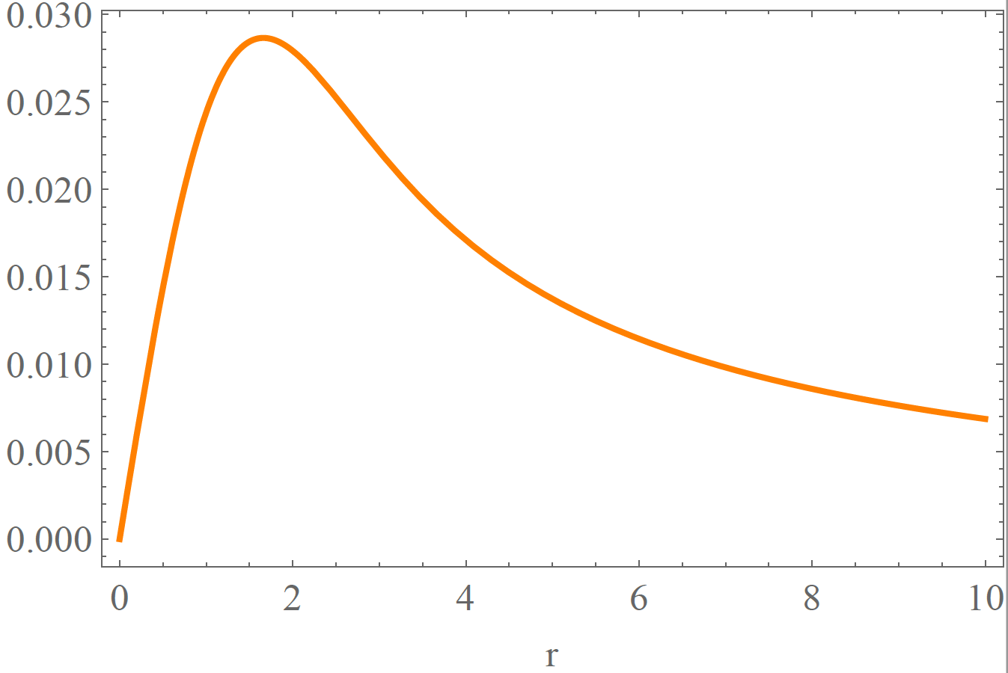
Asymptotic solutions
Asymptotic solutions at large distance:
$$σ\left(r\right)=k_{φ}K_{0}(m_{φ}r)$$
$$U_{θ}(r)=k_{e}rK_{1}(m_{e}r)$$
$${\tilde{φ}}_{r}(r)=k_{\tilde{φ}}K_{0}(m_{\tilde{φ}}r)$$
$$\tilde{s}(r)=k_{s}\ln{r}$$
modified Bessel function $K_{i}\left(mx\right)∝e^{−mx}$ at $x→∞$
Boundary conditions:
Regularity at the origin
$\left|φ\right|=0, A_{μ}=0, ∂_{r}|\tilde{φ|}→ 0,∂_{r}\tilde{s}(r)→ 0,$ at $r=0$
Finite energy
$\left|φ\right|→η_{φ}, { D}_{μ}φ→ 0, \left|\tilde{φ}\right|→ 0 ,$ at $r→∞$
$$k_{φ}∝−|n|$$
$$k_{e}∝−n$$
$$k_{\tilde{φ}}∝\left|ω\right|$$
$$k_{s}∝ω$$
massless
$$\tilde{s}\left(r\right)=ωs(r)$$
$$\tilde{B_{θ}}\left(r\right)∝\frac{1}{r}$$

Slide 12
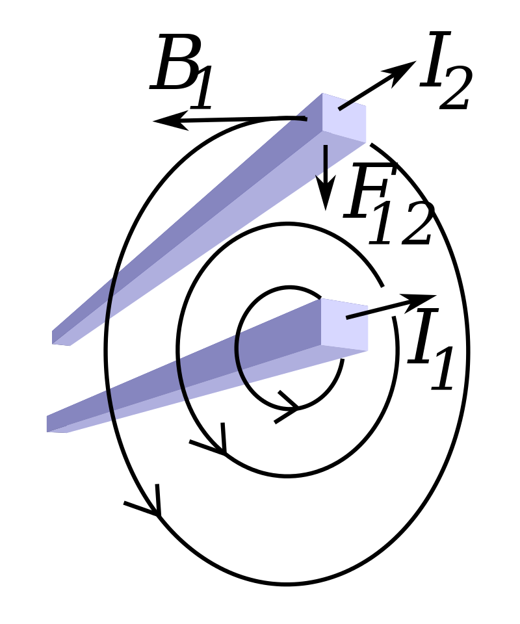
Interaction with source method
Define the external sources
$$ℒ=\frac{1}{2}{\left(∂_{μ}σ\right)}^{2}−\frac{1}{2}m_{φ}^{2}σ^{2}−\frac{1}{4}F^{μν}F_{μν}+\frac{1}{2}m_{e}^{2}U_{μ}U^{μ}−J_{σ}σ−j_{μ}U^{μ}$$
$$+\frac{1}{2}{\left(∂_{μ}{\tilde{φ}}_{r}\right)}^{2}−\frac{1}{2}m_{\tilde{φ}}^{2}{{\tilde{φ}}_{r}}^{2}−\frac{1}{4}\tilde{F^{μν}}\tilde{F_{μν}}−J_{\tilde{φ}}{\tilde{φ}}_{r}−\tilde{j_{μ}}\tilde{A^{μ}}$$
determined by winding direction of vortex
$E_{int}=2π\int{dz}$ $[−k_{φ1}k_{φ2}K_{0}\left(m_{φ}d\right)+k_{A1}k_{A2}K_{0}\left(m_{e}d\right)$
$$−k_{\tilde{φ}1}k_{\tilde{φ}2}K_{0}\left(m_{\tilde{φ}}d\right)+k_{\tilde{A}1}k_{\tilde{A}2}\ln{d}]$$
0
external sources
always attractive contribution
determined by direction of current
$$J_{σ}=−\frac{k_{φ}}{r}δ\left(r\right)$$
$$j_{θ}=−\frac{k_{e}}{m_{e}}∂_{r}(\frac{1}{r}δ\left(r\right))$$
$$J_{\tilde{φ}}=−\frac{k_{\tilde{φ}}}{r}δ\left(r\right)$$
$$\tilde{j_{μ}}=−\frac{k_{s}}{gr}δ\left(r\right)$$
point-like sources in 2-dimensions
Similar as Ampere’s Force
$$k_{φ}∝|n|$$
$$k_{e}∝−n$$
$$k_{\tilde{φ}}∝\left|ω\right|$$
$$k_{s}∝ω$$

Slide 13
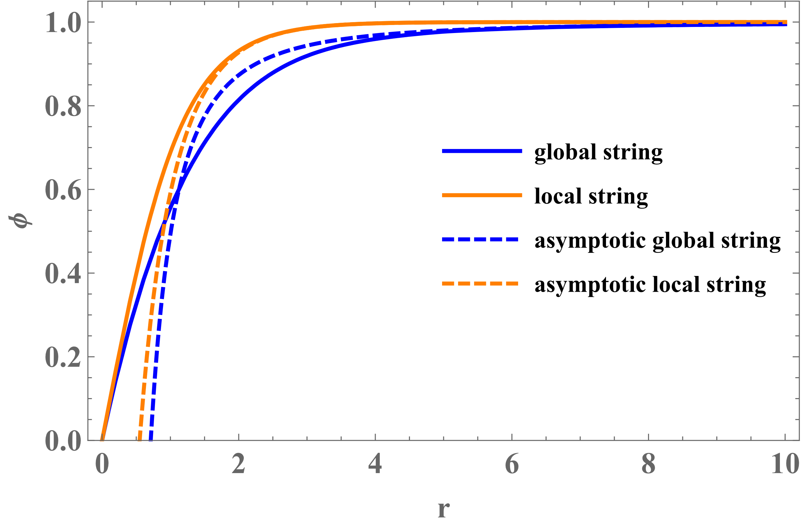
Global strings
$$ℒ={{|∂}_{μ}φ|}^{2}−V\left(φ\right),$$
$$V\left(φ\right)=\frac{1}{4}λ{\left({\left|φ\right|}^{2}−η^{2}\right)}^{2}$$
global $U(1)$
$$φ\left(r\right)=\left(η+\frac{σ\left(r\right)}{\sqrt{2}}\right)e^{iπ(θ)}, π\left(θ\right)=nθ$$
massless Nambu-Goldston boson
$$σ\left(r\right)=−\frac{\sqrt{2}n^{2}η}{m^{2}r^{2}}$$
$$m≡\sqrt{λ}η$$
$E_{π}=2πη^{2}\int{dz}$ $[−n_{1}n_{2}\ln\left(εd\right) ]$
cutoff at $δ=\frac{1}{m}$
$E_{int}=2πη^{2}\int{dz}$ $[−n_{1}n_{2}\ln\left(md\right)−\frac{1}{λ}n_{1}^{2}n_{2}^{2}\frac{1}{d^{2}}\ln\left(m^{2}d^{2}\right)]$
$$J_{σ}=\frac{\sqrt{2}n^{2}η}{r^{2}}$$
$$J_{π}=\frac{nη}{r}δ\left(r\right)$$
suppressed at large distance

Slide 14
What about short-range interaction?
What happen when two strings look closely at each other?
?
? analytically unknow
Far
Close
Only numerical answers.

Slide 15
Numerical calculation
looking for static, lowest energy states of the system
Method: Gradient Flow
initial guess satisfying boundary conditions
evolve the fields with time
field $X_{i}\left(r, θ\right)→ X_{i}\left(t, r, θ\right)$
$$EOM of X_{i}=0 →EOM of X_{i}=∂_{t}X_{i}$$
fixing the center of strings by hand
converge symbol: $∂_{t}X_{i}=0$
Diffusion equation

Slide 16
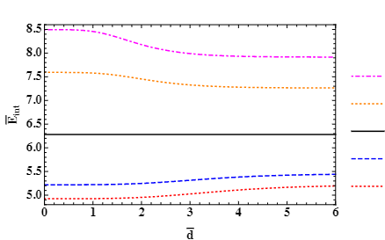
Numerical calculation for local strings
Interaction energy, depending on separation distance
Abelian-Higgs model
$$ℒ_{AH}=−\frac{1}{4}F^{μν}F_{μν}+{\left|D_{μ}φ\right|}^{2}−V\left(φ\right), V\left(φ\right)=\frac{1}{4}λ{\left({\left|φ\right|}^{2}−η^{2}\right)}^{2}$$
$$G=3.0$$
$$G=2.0$$
At $\overline{d}=0, n=2$ solutions
$$G=1.0$$
$$G=0.5$$
point source approximation
$$G=0.4$$
attractive
$$G$$
$$G$$
$E_{int}=2π\int{dz}$ $[−k_{φ1}k_{φ2}K_{0}\left(m_{φ}d\right)+k_{A1}k_{A2}K_{0}\left(m_{e}d\right)]$
repulsive
cancel at $G≡\frac{m_{φ}^{2}}{m_{e}^{2}}=1$
J&R: [Jacobs & Rebbi, Physcis Review B, 1979]

Slide 17
Numerical result for bosonic superconducting
Zero current case:
Bosonic superconducting model(without current: ${\tilde{A}}_{μ}=0$)
$$ℒ_{BC}=−\frac{1}{4}F^{μν}F_{μν}+{\left|D_{μ}φ\right|}^{2}+{\left|\tilde{∂_{μ}}\tilde{φ}\right|}^{2}−V\left(φ, \tilde{φ}\right), V\left(φ, \tilde{φ}\right)=\frac{1}{4}λ_{φ}{\left({\left|φ\right|}^{2}−{η_{φ}}^{2}\right)}^{2}+\frac{1}{4}λ_{\tilde{φ}}{\left({\left|\tilde{φ}\right|}^{2}−{η_{\tilde{φ}}}^{2}\right)}^{2}+β{\left|φ\right|}^{2}{\left|\tilde{φ}\right|}^{2}$$
with parameters $λ_{φ}=8, β=24,$ $λ_{\tilde{φ}}=80,$ $η_{\tilde{φ}}=0.55, eη_{φ}=1.$
d=1
d=2
$\tilde{φ}$ merger
(heaviest)

Slide 18
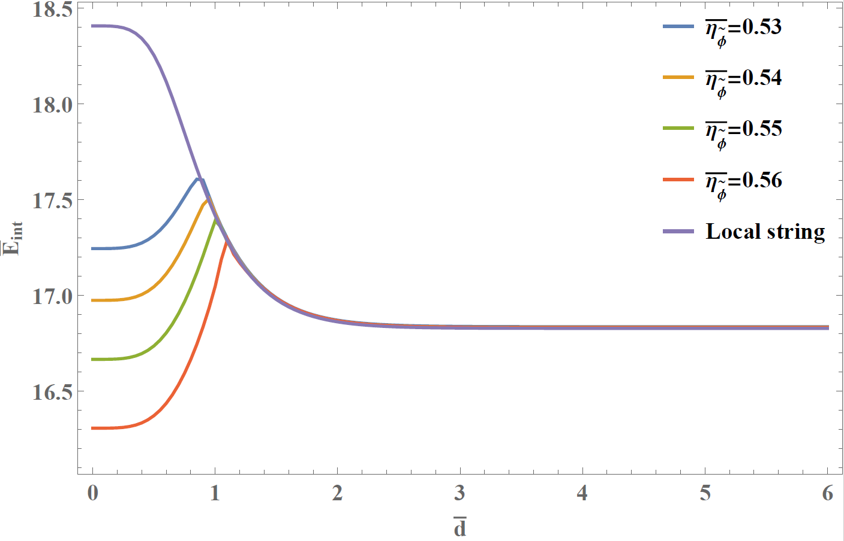
Numerical result for bosonic superconducting
Interaction energy of zero current strings:
$E_{int}=2π\int{dz}$ $[−k_{φ1}k_{φ2}K_{0}\left(m_{φ}d\right)+k_{A1}k_{A2}K_{0}\left(m_{e}d\right)−k_{\tilde{φ}1}k_{\tilde{φ}2}K_{0}\left(m_{\tilde{φ}}d\right)]$
always attractive contribution

Slide 19
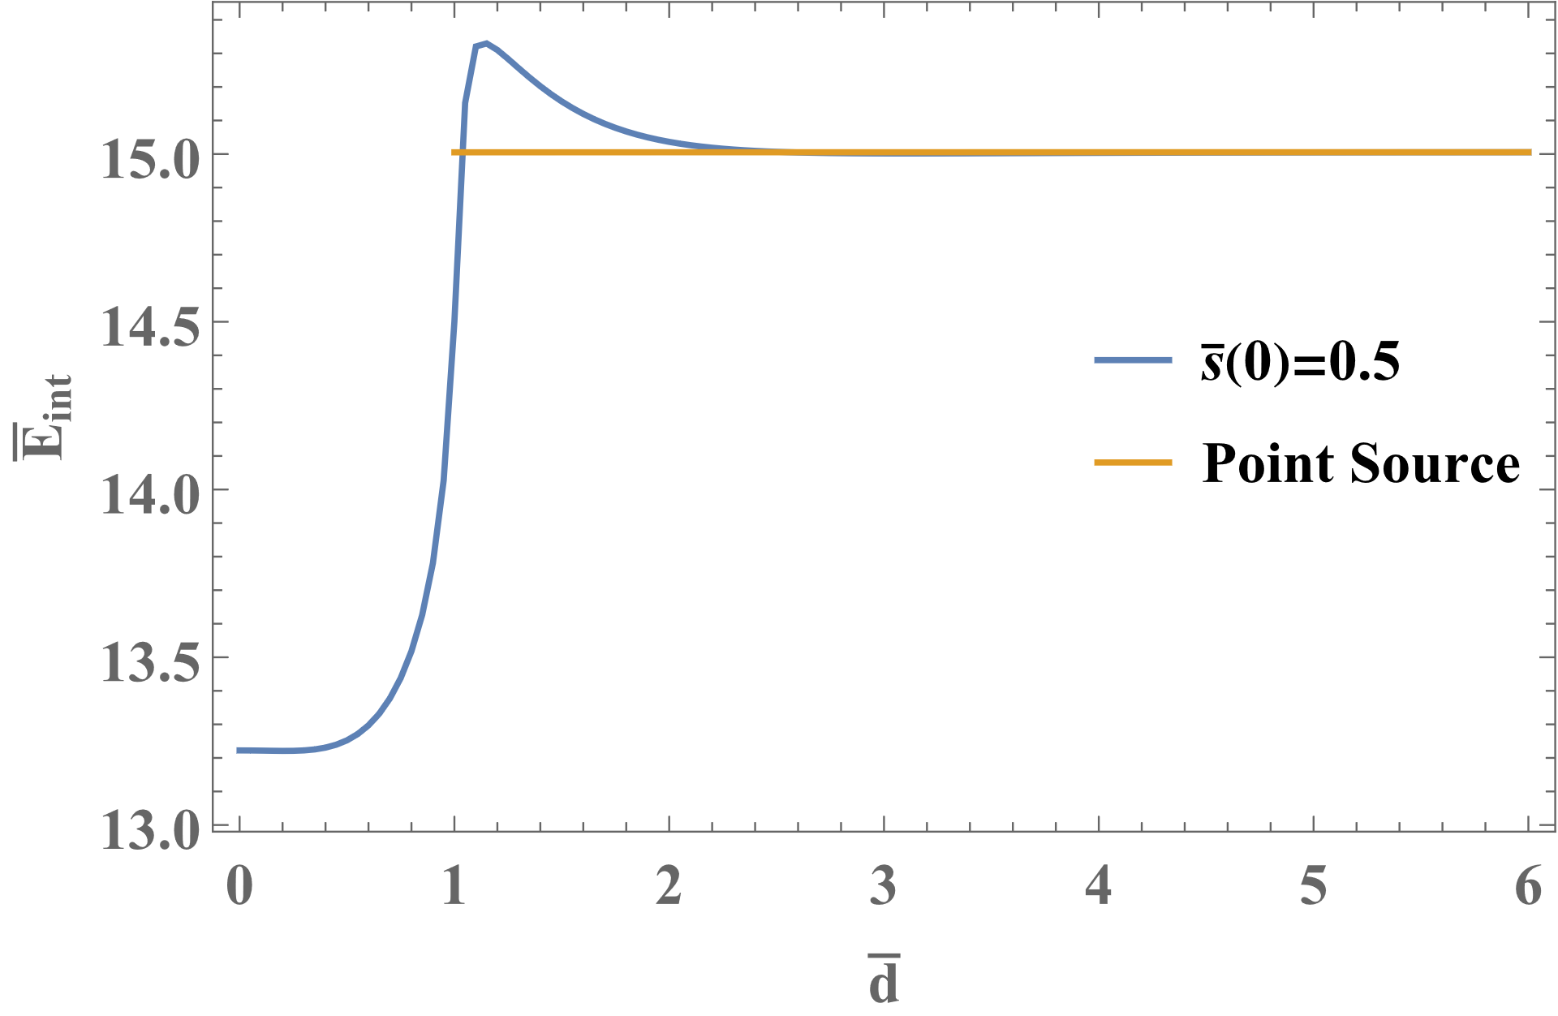
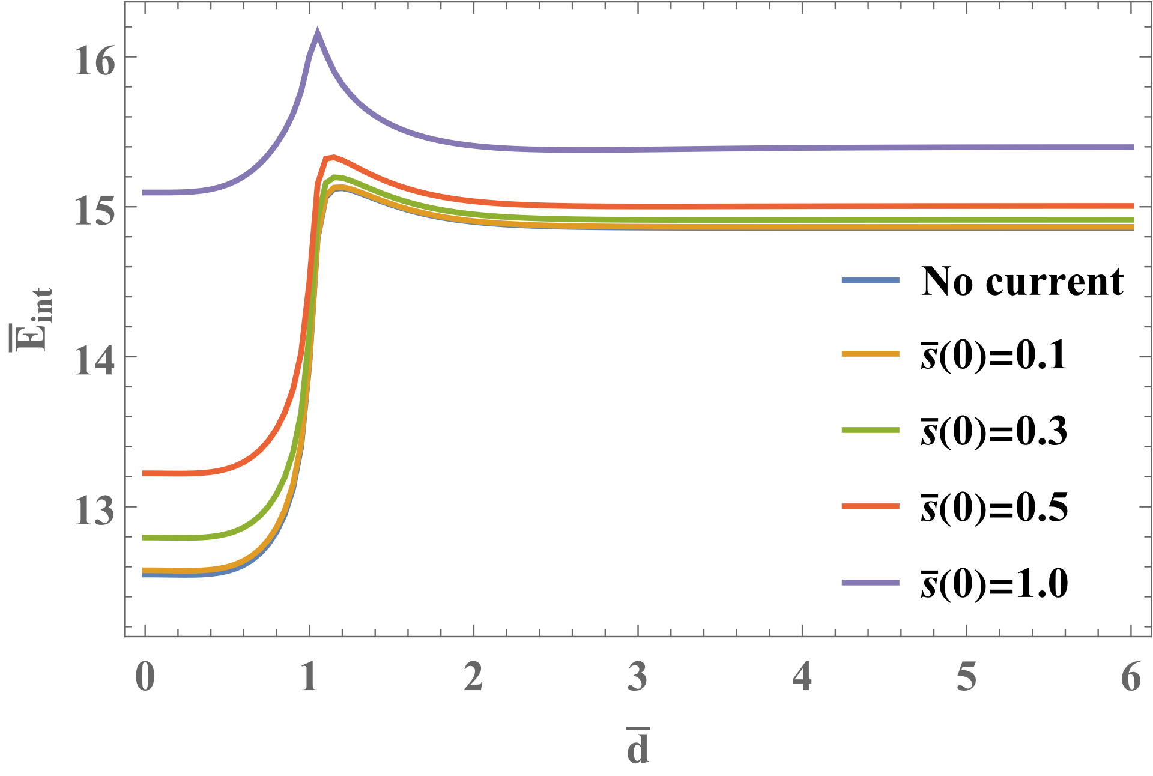
Numerical result for bosonic superconducting
Non-zero current case:
$$k_{\tilde{A}}\sim {10}^{−3}$$
$$J_{z}\sim 0.06$$
consistent with superposition at large distance
$E_{int}=2π\int{dz}$ $[−k_{φ1}k_{φ2}\left(m_{φ}d\right)+k_{A1}k_{A2}K_{0}\left(m_{e}d\right)$
$$−k_{\tilde{φ}1}k_{\tilde{φ}2}K_{0}\left(m_{\tilde{φ}}d\right)+k_{\tilde{A}1}k_{\tilde{A}2}\ln{d}]$$
too small to be seen

Slide 20
Current quenching
,
Reason for small current & small $k_{\tilde{A}}$
,
Effective mass of $\tilde{φ}$:
$$m_{\tilde{φ}}^{2}=β{\left|φ\right|}^{2}−\frac{1}{2}λ_{\tilde{φ}}η_{\tilde{φ}}^{2}+{\tilde{s}}^{2}(r=0)$$
At $r=0, \left|φ\right|=0$,
$$m_{\tilde{φ}}^{2}(r=0)=−\frac{1}{2}λ_{\tilde{φ}}η_{\tilde{φ}}^{2}+{\tilde{s}}^{2}(r=0)$$
As |$\tilde{s}(r=0)$| increases, $|\tilde{φ}|$ is suppressed to zero.
Current
has a maximum value.
$$\tilde{φ}$$
$$\tilde{φ}(0)$$
$$\tilde{s}(0)$$
[R.L. Davis, E.P.S. Shellard, Physcis Letter B, 1988 ]
$$J_{z}=∫d^{2}x[−2g\tilde{s}\left(r\right){\tilde{φ}}_{r}^{2}]$$

Slide 21
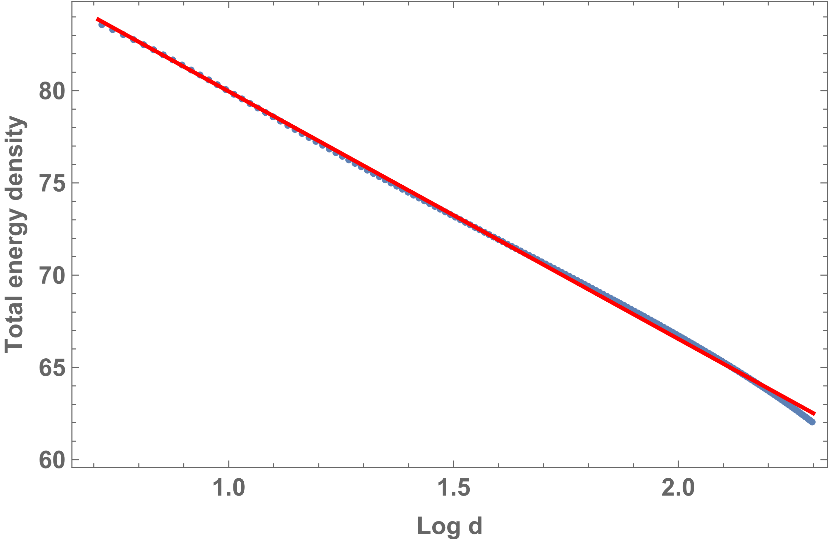
Numerical calculation for global strings
dominant at large distance
$$ℒ={{|∂}_{μ}φ|}^{2}−V\left(φ\right),$$
$$V\left(φ\right)=\frac{1}{4}λ{\left({\left|φ\right|}^{2}−η^{2}\right)}^{2}$$
$E_{int}=2πη^{2}\int{dz}$ $[−n_{1}n_{2}\ln\left(md\right)−\frac{1}{λ}n_{1}^{2}n_{2}^{2}\frac{1}{d^{2}}\ln\left(m^{2}d^{2}\right)]$
global $U(1)$ symmetry
Fig. Blue line is the numerical results , while red line is source method result.
no gauge field to cancel NG boson
long-range interaction

Slide 22
Summary
We investigated interaction between two straight, static, cylindrical symmetric cosmic strings .
Method
Conclusions
Interaction between two static, straight cosmic strings:
well-separated: approximately point sources → interaction dominant by the field with smallest mass at large distance
closely-separated: investigated by numerical calculation
Future work
Simulation of cosmic string network; Formation and distribution of substructures; Prospective observations…
source method approximation
string models
asymptotic solutions
point sources
interaction energy
2-dimension
numerical calculation

Slide 23
Thank you very much for attention.

